Slide 1
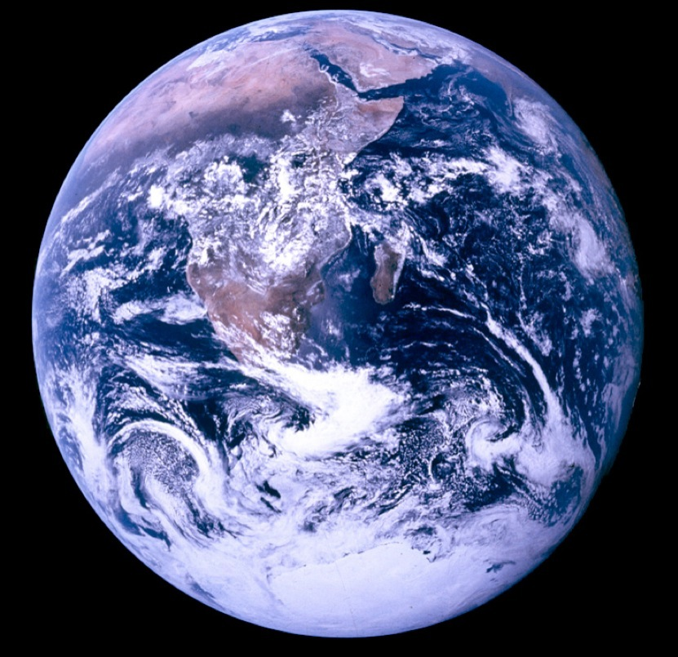
Pat and Steve
Miller
March 27, 2023
SAVING OUR WORLD FROM CLIMATE DESTRUCTION
Source: NASA
Notes:
J:\s\Documents\BE\2022-11-6-Trinity-Episcopal\2022-11-06-Moorestown-Slides.pptx
ID #3 - Can be used in noncommercial online and TV broadcasts of your presentation.
And then on the last of the Apollo missions, this image known as the Blue Marble, became the most reproduced photograph in all of human history. The climate crisis is now the biggest and most serious challenge that humanity has ever faced.
DESCRIPTION: Photo of Earth from Apollo 17, taken as the crew was traveling toward the moon, December 7, 1972
ADDITIONAL TALKING POINTS: This picture is called the “Blue Marble,” taken during the last Apollo mission.
What makes the photograph so unique and powerful is that it captures the complete circle of the earth, helping us see the big picture of our planet – and our lives on it.[1*] It was the first time the Apollo mission made it possible to capture almost the entire southern polar ice cap.[2*]
REFERENCES:
[1*] Ben Cosgrove, “Home, Sweet Home: In Praise of Apollo 17’s ‘Blue Marble’,” Time, April 11, 2014. http://time.com/3879555/blue-marble-apollo-17-photo-of-earth-from-space/
[2*] NASA Visible Earth, “The Blue Marble from Apollo 17," December 7, 1972. http://visibleearth.nasa.gov/view.php?id=55418

Slide 2

WHY WE WANT TO SAVE THE WORLD
TO LEAVE A LIVABLE WORLD FOR OUR GRANDCHILDREN

Slide 3
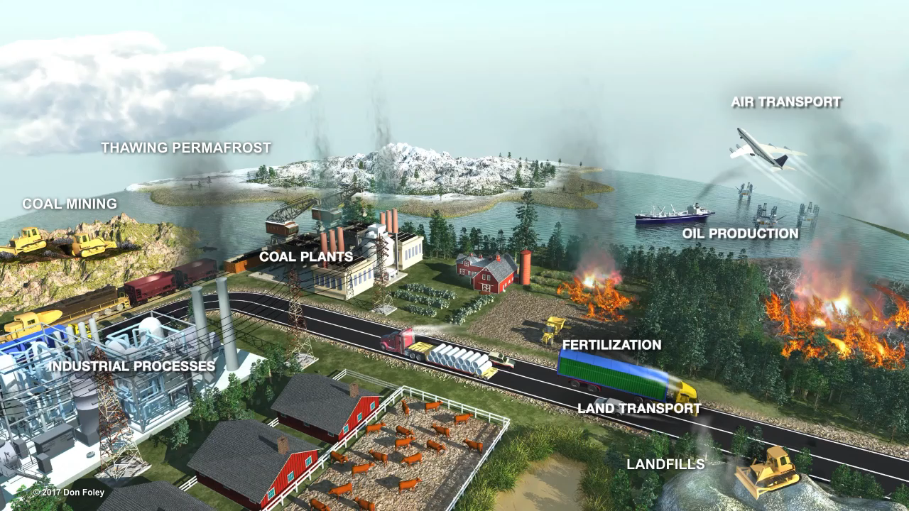
Notes:
This Truth in Ten slide deck is available to the public, not just Climate Reality Leaders, to be used in noncommercial, nonpromotional presentations broadcast on TV, streamed online, and in-person, but this slide may not be modified.
TALKING POINTS:
There are many sources of human-caused global warming pollution: agricultural practices, forest burning, transportation, and many other factors.
But the main source and cause of the rising global temperatures we are seeing today is the burning of fossil fuels.

Slide 4
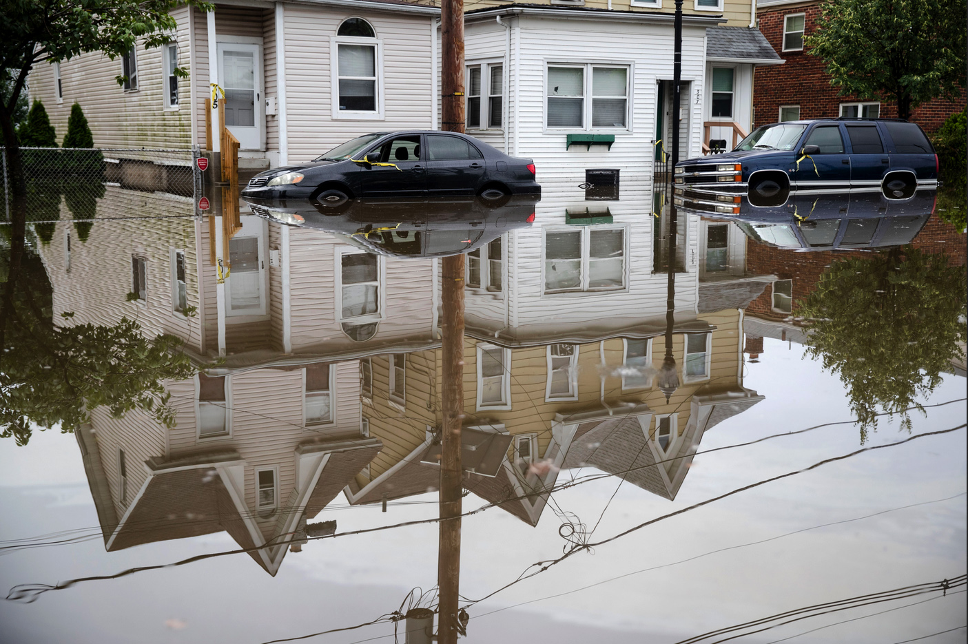
Westville, New Jersey
June 20, 2019
Notes:
ID #6101 - May not be modified or used in presentations that are recorded, streamed, or broadcast.
This was in New Jersey.
DESCRIPTION: Photo of a man wading through waist-high flooded waters in Westville, New Jersey on June 20, 2019
ADDITIONAL TALKING POINTS: As the world gets warmer, the extra heat is intensifying the water cycle and leading to more extreme floods in many places around the world.[1*]
Floods are caused or amplified by both weather- and human-related factors.
Major weather factors include heavy and/or prolonged precipitation, snowmelt, thunderstorms, storm surges from hurricanes, and collapsed ice or debris jams in waterways.[1*]
Human factors include structural failures of dams and levees, altered drainage, and land-cover alterations.[1*]
Heavy downpours are instances when the amount of rain or snow exceeds what is normal, which varies by location and season, and these events are on the rise with climate change.[2*]
There are four major flood categories: flash, urban, river, and coastal flooding.[1*]
Flash floods occur in small and steep watersheds and waterways and can be caused by short-duration intense precipitation.[1*] Low lying areas or areas with poor drainage have increased vulnerability.[2*]
Urbanization creates large areas of impervious surfaces (such as roads, pavement, parking lots, and buildings). During brief but very heavy precipitation, these surfaces increase immediate runoff that can exceed the capacity of storm drains and lead to urban flooding.[1*]
River flooding occurs when surface water drained from a watershed into a stream or a river exceeds channel capacity, overflows the banks, and inundates adjacent low-lying areas.[1*] Between 13–41 million US residents are now at risk due to river flooding.[3*]
Coastal flooding is predominantly caused by storm surges that accompany hurricanes and other storms that push seawater toward the shore.[1*]
Extreme floods used to be rare events but in recent years they have become more frequent, intense, and costly.[4*]
In the past two decades, the world’s 10 worst floods have done more than $165 billion in damage and have driven more than 1 billion people from their homes.[5*]
By 2050, flooding is projected to inundate coastal cities an average of 40 times more often than present day.[4*]
The risk of extreme floods – such as those caused by Hurricane Sandy in 2012 – striking will likely increase to about once per year after 2100.[4*]
REFERENCES:
[1*] National Climate Assessment, “Extreme Weather,” last accessed February 2020. https://nca2014.globalchange.gov/highlights/report-findings/extreme-weather
[2*] Environmental Protection Agency, “Climate Change Indicators: Heavy Precipitation,” last updated August 2016. https://www.epa.gov/climate-indicators/climate-change-indicators-heavy-precipitation
[3*] FloodList News, “New Study Finds Over 40 Million Americans at Risk from River Flooding,” March 1, 2018. http://floodlist.com/america/usa/study-40-million-americas-flood-risk
[4*] Georgina Gustin, “U.S. Coastal Cities Will Flood More Often and More Severely, Study Warns,” Inside Climate News, June 7, 2017. https://insideclimatenews.org/news/07062017/coastal-flooding-extreme-sea-level-rise-forecast
[5*] Emily Anthes, “A Floating House to Resist the Floods of Climate Change,” The New Yorker, January 3, 2018. https://www.newyorker.com/tech/elements/a-floating-house-to-resist-the-floods-of-climate-change

Slide 5
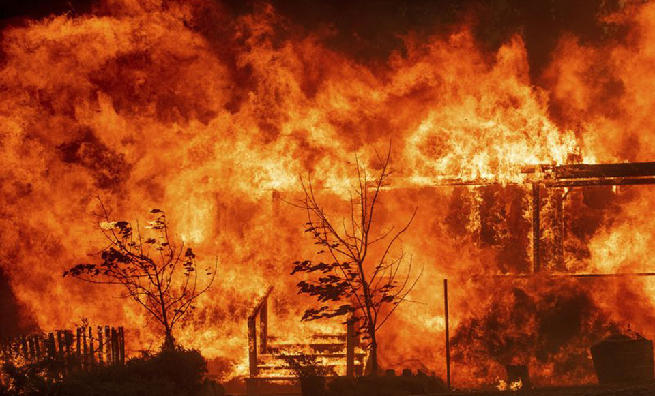
California, August 13, 2020
The Lake Fire grew to 10,000 acres within 1 day
Notes:
ID #6447 - May be live-streamed, broadcast, and presented in-person, but may not be recorded or modified.
In California last fall, they had devastating fires.
DESCRIPTION: Photo of embers flying across a roadway as the Kincade Fire burned through the Jimtown community of Sonoma County, California on October 24, 2019
ADDITIONAL TALKING POINTS: Research shows that changes in climate have led to hot, dry conditions that increase the risk of fire activity.[1*]
Wildfires are increasing in size, intensity, and duration, burning hotter and longer.[1*]
Fire seasons are also lasting longer.[2*]
Five main factors contribute to increased fire activity in some areas.[3*]
First, spring and summer are coming earlier and lasting longer, respectively, and arrive with more extreme temperatures.
Second, with spring arriving earlier, snowpack is melting sooner, resulting in less water available during the hottest months and giving vegetation more time to dry out.
Third, plants lose water during transpiration — and the higher the ambient temperature, the more water they lose, leaving them drier and more susceptible to fire.
Fourth, studies show that lightning-induced North American forest fires have increased since 1975 and predict that the number of lightning strikes in the United States could increase by about 12 percent for every degree Celsius of warming.
Finally, evidence suggests that climate change may cause more extreme winds in some parts of the world, fanning more flames when fires do break out.
Compared to natural causes, wildfires are most often the result of human activity, stemming from debris burning, arson, campfires, and fireworks – all made more dangerous under drier conditions.[2*]
In recent decades, man-made fires are estimated to have tripled the average fire season.[2*]
As of 2019, up to 90 percent of all US wildland fires were intentionally or accidentally caused by people.[4*]
Annually, wildfires can already burn millions of hectares and force hundreds of thousands to evacuate, with consequences for both immediate safety and long-term health.[5*]
Triggered by warmer temperatures and drier conditions, wildfires and related damages are projected to increase globally this century, particularly in parts of Europe and throughout western North America.[6*]
Since 1972, California’s annual burned area has increased by more than five times. In the past decade, California saw five of its 10 largest wildfires, and experienced seven of the 10 most destructive wildfires in state history – including the Camp Fire, California’s deadliest wildfire.[7*]
Forest fires are also a major threat to air quality: particle emissions can lead to increased health issues, such as cardiac and respiratory disease, as well as direct mortality.[6*]
Australia experienced its hottest and driest year on record in 2019, resulting in drier lands and early fires.[8*]
While fires have historically occurred primarily in places where few people lived, the 2019-2020 Australian fires were different, affecting populated areas. In New South Wales and Victoria alone, about 16 million acres of land burned, while millions more burned in other parts of the country, killing about 30 people, an estimated billion animals, and destroying at least 2,500 homes.[8*]
REFERENCES:
[1*] Center For Climate And Energy Solutions, “Wildfires and Climate Change,” last accessed July, 2020. https://www.c2es.org/content/wildfires-and-climate-change/
[2*] Jason Daley, “Study Shows 84% Of Wildfires Caused By Humans,” Smithsonian Magazine, February 28, 2017. https://www.smithsonianmag.com/smart-news/study-shows-84-wildfires-caused-humans-180962315/
[3*] Chelsea Harvey, “Here’s What We Know About Wildfires and Climate Change,” Climate Wire, Scientific American, October 13, 2017. https://www.scientificamerican.com/article/heres-what-we-know-about-wildfires-and-climate-change/
[4*] Insurance Information Institute, “Facts + Statistics: Wildfires,” last accessed July, 2020. https://www.iii.org/fact-statistic/facts-statistics-wildfires
[5*] Union Of Concerned Scientists, "The Connection Between Climate Change and Wildfires," last updated March 11, 2020. https://www.ucsusa.org/resources/climate-change-and-wildfires#.WuIWwtPwZTY
[6*] R. Sari Kovats et al., “Climate Change 2014: Impacts, Adaptation, and Vulnerability. Part B: Regional Aspects,” Contribution of Working Group II to the Fifth Assessment Report of the Intergovernmental Panel on Climate Change, Cambridge University Press, Section 23.4.4 (March 31, 2014): Pages 1267-1326. https://www.ipcc.ch/site/assets/uploads/2018/02/WGIIAR5-PartB_FINAL.pdf
[7*] Robinson Meyer, “California’s Wildfires Are 500 Percent Larger Due to Climate Change,” The Atlantic, July 16, 2019. https://www.theatlantic.com/science/archive/2019/07/climate-change-500-percent-increase-california-wildfires/594016/
[8*] Jamie Tarabay, “Why these Australia Fires Are Like Nothing We've Seen Before,” The New York Times, January 21, 2020. https://www.nytimes.com/2020/01/21/world/australia/fires-size-climate.html
SLIDE SOURCE(S): https://www.pressdemocrat.com/news/10216601-181/kincade-fire-starts-inside-the?artslide=0; https://www.usatoday.com/story/news/nation/2019/10/24/kincade-san-bernardino-fires-shutoff-power-california-evacuations/2452820001/

Slide 6
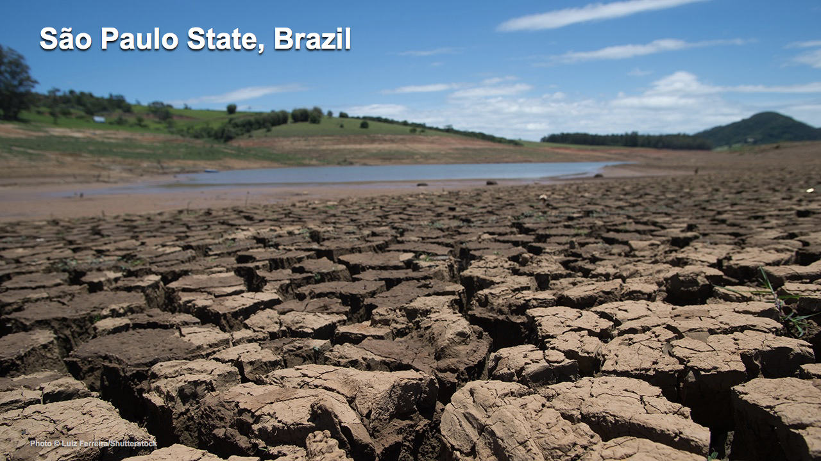
Notes:
This Truth in Ten slide deck is available to the public, not just Climate Reality Leaders, to be used in noncommercial, nonpromotional presentations broadcast on TV, streamed online, and in-person, but this slide may not be modified.
TALKING POINTS:
Changing precipitation patterns can lead to drought and water shortages. Southern Brazil, for example, suffered a devastating drought in 2015 and 2016.
PHOTO: The Sistema Cantareira (Cantareira system), the water supply system in the state of São Paulo, Brazil during a severe drought

Slide 7
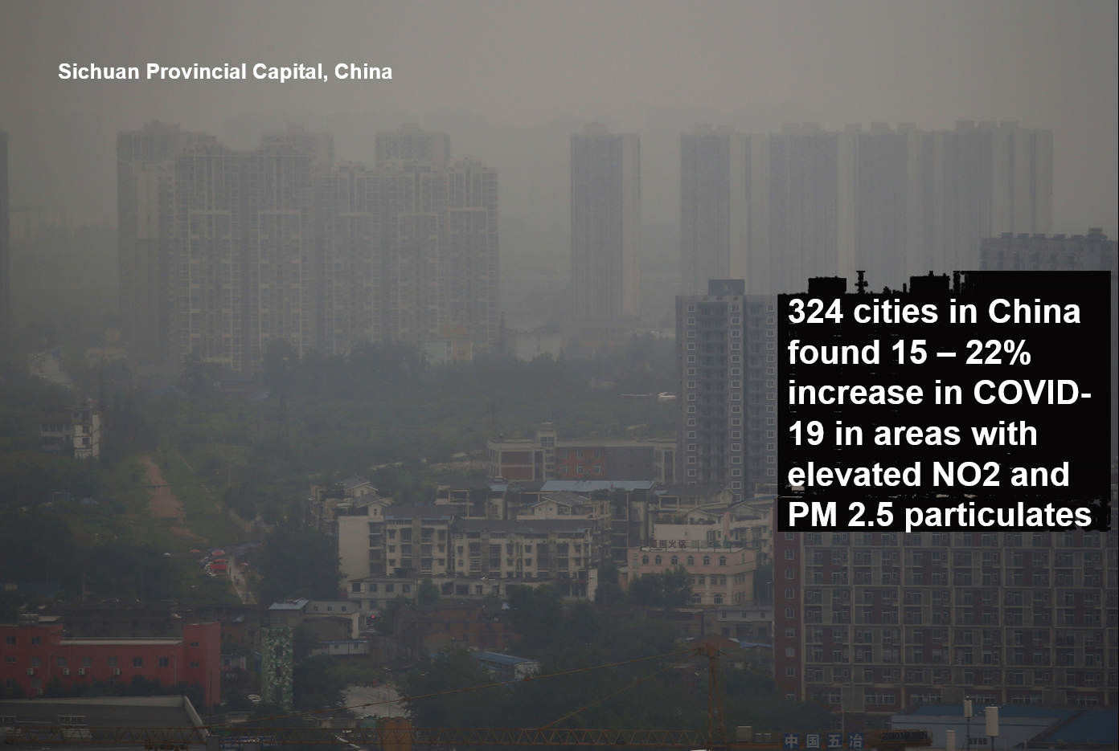
Notes:
ID #6685 - May be live-streamed, broadcast, and presented in-person, but may not be recorded or modified.
It also makes people more vulnerable to the COVID-19 pandemic all over the world. More air pollution, a higher death rate from COVID-19.
DESCRIPTION: Photo of people wearing face masks walking through smog in Changchun, Jilin Province, China on April 15, 2020 with text stating that a study of 324 cities in China found a 15 – 22 percent increase in COVID-19 cases in areas with elevated levels of NO2 and PM 2.5 particulate pollution
ADDITIONAL TALKING POINTS:
Pollution from extracting and burning fossil fuels isn’t only driving the climate crisis – it’s also creating a public and environmental health crisis worldwide.
Burning fossil fuels releases deadly pollution into the air.
Air pollution – such as that produced from burning fossil fuels like coal and oil – can expose people to small particulate matter of 2.5 microns or less in diameter (PM2.5). These particles can penetrate the lung barrier and enter the blood system, resulting in cardiovascular and respiratory diseases, and cancers.[1*]
Ambient outdoor air pollution kills millions of people every year.[1*]
In 2016, around 58 percent of deaths from ambient air pollution were due to ischaemic heart disease and strokes. Another 18 percent were due to chronic obstructive pulmonary disease, 18 percent were due to acute lower respiratory infections, and 6 percent were due to lung cancer.[1*]
Additionally, indoor smoke is a serious health risk for some 3 billion people who use biomass, kerosene fuels, and coal for cooking or for heating their homes.[1*]
People with pre-existing medical conditions are worse off. For example, chronic obstructive pulmonary disease (COPD) patients are especially sensitive to changes in ambient air quality associated with climate change.[2*]
Among the many byproducts of coal combustion is mercury, a potent neurotoxin that can bioaccumulate and biomagnify in organic tissue. Consuming contaminated fish, for example, can seriously harm both people and wildlife.[3*]
Fossil fuel pollution also impacts the water and land.
Coal mining operations can contaminate nearby rivers, lakes, and aquifers with heavy metals like arsenic, copper, and lead. One common technique, mountain top removal, requires clearcutting forests and vegetation before using explosives to blast away the tops of mountains, with the resulting debris typically dumped into the valleys below.[4*]
Before being burned, coal is washed with water and chemicals to remove impurities, producing a coal slurry that must be stored, either with coal ash or in improvised ponds that can leak, spill, or fail.[4*]
In 2000, the bottom of a Kentucky coal slurry impoundment gave way, contaminating more than a hundred miles of rivers and streams with more than 300,000,000 gallons of thick black sludge – a spill 30 times larger than the Exxon-Valdez oil spill.[4*]
Hydraulic fracturing (or “fracking”) is a drilling technique for extracting oil or natural gas by injecting huge quantities of water, chemicals, and sand deep underground, the hazardous consequences of which may include contaminating drinking water supplies and triggering small earthquakes.[5*]
Oil spills, such as from the Deepwater Horizon offshore oil rig in 2010, are devastating environmental disasters with long-lasting effects to the landscape, native species, and inhabitants who depend on the area.[6*]
While pollution is a threat to common resources, some people are disproportionately impacted.
Around the world, poor people are the most affected by air pollution.[7*]
As of 2016, more than 90 percent of air pollution-related deaths occurred in low- and middle-income countries.[1*]
In the United States, due to historical racism and economic inequality, minority and poor communities are most affected by air pollution: Black Americans have a 54 percent higher health burden compared to the overall population; non-White communities overall have a 28 percent higher health burden; and those living below the poverty line have a 35 percent higher burden.[8*]
The biggest polluters, including hazardous waste treatment, storage, and disposal plants, in the US are overwhelmingly located in poor, non-White areas.[9*]
Residents of Louisiana’s “Cancer Alley” – home to about 150 fossil fuel and petrochemical facilities – are about 50 times more likely to get cancer than the average American.[10*]
Fossil fuel pollution is changing our climate – and climate change is making the public health impacts of COVID-19 worse.
While there is no evidence of climate change directly contributing to the emergence of COVID-19, climate change can indirectly affect the larger COVID-19 response due to its impacts on public health and stress on health systems.[11*]
People living with poor air quality – especially those most vulnerable, like the homeless, people with homes lacking air filtration, or people with compromised health – are more likely to die from COVID-19, just as research shows that people exposed to more air pollution and who smoke fare worse with respiratory infections.[12*]
Due to longstanding racist housing policies and practices and other systemic inequalities, communities of color in the US are more likely to live with higher rates of pollution and be at higher risk of getting COVID-19 or contracting severe illness.[13*]
COVID-19 may affect planning and preparing for hurricanes and other natural disasters, as well as recovery efforts, due to the strained medical and personal hygiene resources and difficulty maintaining physical distancing in public shelters.[14*]
REFERENCES:
[1*] World Health Organization, "Ambient (outdoor) air pollution," May 2, 2018. https://www.who.int/news-room/fact-sheets/detail/ambient-(outdoor)-air-quality-and-health
[2*] John Balbus, et al., “Climate and Health Assessment Chapter 1: Climate Change and Human Health,” (The US Global Change Research Program, 2016). https://health2016.globalchange.gov/climate-change-and-human-health
[3*] US Geological Survey, "Mercury," last accessed July 2020. https://usgs.gov/mission-areas/water-resources/science/mercury?qt-science_center_objects=0#qt-science_center_objects
[4*] Union of Concern Scientists, "Coal and Water Pollution," December 6, 2017. https://www.ucsusa.org/resources/coal-and-water-pollution
[5*] Marc Lallanilla, "Facts About Fracking," Live Science, February 10, 2018. https://www.livescience.com/34464-what-is-fracking.html
[6*] US Geological Survey, "Large Oil Spills," last accessed July 2020. https://www.usgs.gov/mission-areas/water-resources/science/large-oil-spills
[7*] UN Environment, “Air pollution hurts the poorest most,” May 9, 2019. https://www.unenvironment.org/news-and-stories/story/air-pollution-hurts-poorest-most
[8*] Miranda Green, “EPA scientists find black communities disproportionately hit by pollution,” The Hill, February 23, 2018. https://thehill.com/policy/energy-environment/375289-epa-scientists-find-emissions-greater-impact-low-income-communities
[9*] Erik Sherman, “If You’re a Minority and Poor, You’re More Likely to Live Near a Toxic Waste Site,” Fortune, February 4, 2016. https://fortune.com/2016/02/04/environmental-race-poverty-flint/
[10*] James Pasley, “Inside Louisiana’s horrifying ‘Cancer Alley,’ an 85-mile stretch of pollution and environmental racism that’s now dealing with some of the highest coronavirus death rates in the country,” Business Insider, April 9, 2020. https://www.businessinsider.com/louisiana-cancer-alley-photos-oil-refineries-chemicals-pollution-2019-11#to-get-an-idea-of-the-toxicity-people-living-in-reserve-louisiana-are-50-times-more-likely-to-get-cancer-than-an-average-american-3
[11*] World Health Organization, "Q&A: Climate change and COVID-19," April 22, 2020. https://www.who.int/news-room/q-a-detail/q-a-on-climate-change-and-covid-19
[12*] Harvard T.H. Chan School of Public Health, "Coronavirus and Climate Change," last accessed July 2020. https://www.hsph.harvard.edu/c-change/subtopics/coronavirus-and-climate-change/
[13*] Center for Disease Control, “COVID-19 in Racial and Ethnic Minority Groups,” June 25, 2020. https://www.cdc.gov/coronavirus/2019-ncov/need-extra-precautions/racial-ethnic-minorities.html
[14*] US Centers for Disease Control and Prevention, "Natural Disasters, Severe Weather, and COVID-19," last updated July 1, 2020. https://www.cdc.gov/disasters/covid-19/disasters_severe_weather_and_covid-19.html
SLIDE SOURCE(S): https://www.medrxiv.org/content/10.1101/2020.04.21.20073700v1

Slide 8


The Cost of Carbon
Political Instability
Species Extinction
Floods & Mudslides
Melting Glaciers
$
$
$
$
$
$
Wildfires
Famine
Drought
Water Scarcity
Storm Damage
Ecosystem Loss
Ocean Acidification
Our Way of Life
Infrastructure Loss
Infectious Diseases
Climate Refugees
Sea Level Rise
… And much, much more
“The #1 Threat to the
Global Economy”
© 2005 iStockphoto/themoog
Notes:
ID #3723 - Can be used in noncommercial online and TV broadcasts of your presentation, but not modified.
So, when you add up all of these costs, and we haven't even talked about ocean acidification or infrastructure, or some of these others, I will add one more: It's the number one threat to the global economy. Fourth year in a row it's been designated as such.
DESCRIPTION: Animated slide covering the various costs of carbon, including, but not limited to: political instability, drought, famine, sea level rise, ocean acidification, water scarcity, climate refugees, storm damage, floods and mudslides, infectious diseases, wildfires, melting glaciers, ecosystem loss, species extinction, infrastructure loss, and our way of life
ADDITIONAL TALKING POINTS:
To meet the goals of the Paris Agreement, approximately half of gas reserves and more than 80 percent of proven coal reserves must stay in the ground.[1*]
The Social Cost of Carbon.[2*]
Mining, drilling, and burning fossil fuels like coal, oil, and natural gas are harming our environment and our health. We see the cost of carbon clearly in devastating impacts from extreme weather events like flooding and deadly storms to fast-spreading diseases to rising seas to ecosystem loss. What we don’t always see are the costs of the lingering aftermath and recovery from these disasters, such as increased health care expenses, destruction of property, increased food prices, and more.
The current estimate of the social cost of carbon is roughly $50 per ton, which many experts argue is far lower than the true cost of carbon pollution.
As the world moves fast to a low-carbon economy, investments in fossil fuels reaching into the trillions will become lost as stranded assets.
According to a 2018 study, up to $4 trillion worth of fossil fuel assets could be wiped off the global economy due to changes in technology, markets, and social habits.[1*]
Furthermore, there is a reputational risk for investors that their investment is not in line with global climate goals, which is a growing concern among many institutional investors around the world.[3*]
The CEO of the Colombian coal giant, Cerrejon, agrees that the coal industry is in terminal decline and prices continue to plunge.[4*]
Global investments in fossil fuels continued to rise in recent years, despite many of the world’s most prominent investors divesting from fossil fuels.
The International Energy Agency’s World Energy Investment 2020 report estimates that clean energy investment has been relatively resilient in the 2020 economic downturn. However, investments in renewables have been stagnant since 2015 and are far from the level needed for emissions reductions.[5*]
The energy return on investment (how much energy a source will produce compared to how much energy it takes to extract or develop the source) for fossil fuels is getting lower and lower, especially as easily accessible fossil fuel resources become exhausted. On the other hand, as renewable infrastructure is built out, the energy return on investment for renewable sources will likely increase, further building the case for increasing investment in renewables.[6*]
As of early 2020, nearly 1,200 institutions across world, representing over $14 trillion in assets under management, have pledged to divest from their investments in coal, oil, and gas companies.[7*]
REFERENCES:
[1*] Joel Makower, “The growing concern over stranded assets,” GreenBiz, September 10, 2019. https://www.greenbiz.com/article/growing-concern-over-stranded-assets
[2*] Environmental Defense Fund, “The true cost of carbon pollution,” last accessed July 7, 2020. https://www.edf.org/true-cost-carbon-pollution
[3*] Bill McKibben, “At last, divestment is hitting the fossil fuel industry where it hurts,” The Guardian, December 16, 2018. https://www.theguardian.com/commentisfree/2018/dec/16/divestment-fossil-fuel-industry-trillions-dollars-investments-carbon
[4*] Matthew Bristow, “One Coal CEO Sees Writing on Wall, Says Make Money While You Can,” Bloomberg, August 9, 2019. https://www.bloomberg.com/news/articles/2019-08-09/one-coal-ceo-sees-writing-on-wall-says-make-money-while-you-can
[5*] International Energy Agency, “World Energy Investment 2020,” May, 2020. https://www.iea.org/reports/world-energy-investment-2020
[6*] University of Leeds, "Fossil fuels increasingly offer a poor return on energy investment," July 11, 2019. https://www.sciencedaily.com/releases/2019/07/190711114846.htm
[7*] Fossil Free Divestment, “1000+ Divestment Commitments,” last accessed July, 2020. https://gofossilfree.org/divestment/commitments/
SLIDE SOURCE(S): https://www.weforum.org/reports/the-global-risks-report-2019

Slide 9
NJDEP GWRA Report 80 x 50 https://www.nj.gov/dep/climatechange/docs/nj-gwra-80x50-report-2020.pdf

Slide 10
We have
the solutions
at hand...
Notes:
ID #1630 - Can be used in noncommercial online and TV broadcasts of your presentation, but not modified.
Well, luckily the answer to that question is yes, too, because we have the solutions at hand.
DESCRIPTION: Text slide stating that we have solutions to the climate crisis at hand

Slide 11
Global Wind Energy Capacity
1980 – Present
Wind Capacity (Megawatts)
2019
Data: Earth Policy Institute/Bloomberg New Energy Finance
Notes:
ID #3089.F - Can be used in noncommercial online and TV broadcasts of your presentation, but not modified.
…
DESCRIPTION: Graph showing the growth of global wind energy capacity in megawatts, 1980 - 2019
ADDITIONAL TALKING POINTS:
With demand for electricity growing and the climate crisis deepening, the world needs a viable, cost-competitive replacement for dirty fossil fuels. Wind energy can be an excellent alternative, powering our lives without destroying our planet.
Wind energy has the potential to supply the world’s electricity needs 40 times over.[1*]
Global wind capacity reached almost 650 GW in 2019[2*]. Wind capacity is expected to quadruple by 2040, relative to 2017 , with $3.3 trillion in investments.[3*]
Wind and solar are the cheapest sources of electricity generation for people across more than two-thirds of the world as of 2019.[4*]
In 2000, the International Energy Agency projected global wind capacity would only reach 30 GW by 2010. Instead in 2010, it reached 200 GW, overshooting projections by over 660 percent.[5*]
Global offshore wind markets are surging, and turbines are growing more powerful.
Global offshore wind is expected to grow dramatically, with projections showing the potential for up to a 15-fold increase in capacity and around $1 trillion of cumulative investment by 2040.[6*]
Offshore turbines are experiencing an arms race, with individual turbines getting larger. One rotation of a Vestas 8.8 MW wind turbine is enough to power the average home in the United Kingdom for an entire day and next generation turbines are expected to be even larger at 12–15 MW.[7*]
Expanding wind energy will help bring abundant and affordable clean energy and good jobs to people across the globe for years to come.
Employment in wind power, primarily onshore projects, supports 1.2 million jobs around the world. China is the largest employer (44 percent of total jobs). In the US, wind employment grew 8 percent in 2018. Now, wind employs 114,000 Americans in total.[8*]
Global employment in the industry is expected to grow significantly from 1.16 million jobs in 2018 to over 3.7 million jobs in 2030 and more than 6 million in 2050.[9*]
The US wind industry hires veterans at a rate 67 percent higher than the national average. The industry also supports 24,000 manufacturing jobs at over 500 US factories.[10*]
Renewable energy also leads the field in equitable hiring, with women making up about 32 percent of the renewable workforce, compared to 22 percent in the energy sector overall.[11*]
Wind energy is a staple in the US and provides much-needed tax revenue to rural communities.
In 2019, the US added 9,143 MW of new wind capacity, enough to power over 3 million homes, and the wind industry had the third-strongest year on record.[12*]
Wind energy is taking off in the US, with another 44,000 MW of capacity under construction or in advanced development, representing over $62 billion in investment.[12*]
REFERENCES:
[1*] Xi Lua, Michael B. McElroy, and Juha Kiviluoma, “Global Potential for Wind-Generated Electricity,” Proceedings of the National Academy of Sciences of the United States of America 106, No. 27 (July 7, 2009): 10933-10938. http://www.pnas.org/content/106/27/10933.full.pdf
[2*] World Wind Energy Association, “World wind capacity at 650,8 GW, Corona crisis will slow down markets in 2020, renewables to be core of economic stimulus programmes,” April 16, 2020. https://wwindea.org/blog/2020/04/16/world-wind-capacity-at-650-gw/
[3*] Bloomberg New Energy Finance, “Global wind and solar costs to fall even faster, while coal fades even in China and India,” June 15, 2017. https://about.bnef.com/blog/global-wind-solar-costs-fall-even-faster-coal-fades-even-china-india/
[4*] Bloomberg New Energy Finance, “New Energy Outlook 2019,” (2019). https://bnef.turtl.co/story/neo2019?teaser=true
[5*] David Roberts, “Why do ‘experts’ always lowball clean energy projections?," Grist, July 9, 2012. http://grist.org/renewable-energy/experts-in-2000-lowballed-the-crap-out-of-renewable-energy-growth/
[6*] International Renewable Energy Agency, “Offshore wind to become a $1 trillion industry,” October 25, 2019. https://www.iea.org/news/offshore-wind-to-become-a-1-trillion-industry
[7*] Jason Deign, “Global Wind Market to Add 65 GW per Year to 2027,” GreenTechMedia, January 1, 2019. https://www.greentechmedia.com/articles/read/global-wind-market#gs.wtl6fv
[8*] International Renewable Energy Agency, “Renewable Energy and Jobs – Annual Review 2019,” (June 2019). https://www.irena.org/-/media/Files/IRENA/Agency/Publication/2019/Jun/IRENA_RE_Jobs_2019-report.pdf
[9*] International Renewable Energy Agency, “Future of wind: Deployment, investment, technology, grid integration and socio-economic aspects,” (October 2019). https://irena.org/-/media/Files/IRENA/Agency/Publication/2019/Oct/IRENA_Future_of_wind_2019.pdf
[10*] T&D World, “U.S. Wind Power Grows a Record 8% in 2018,” April 17, 2019. https://www.tdworld.com/renewables/us-wind-power-grows-record-8-2018
[11*] International Renewable Energy Agency, “Renewable Energy: A Gender Perspective,” (January 2019). https://www.irena.org/publications/2019/Jan/Renewable-Energy-A-Gender-Perspective
[12*] American Wind Energy Association, “Wind Industry Experiences Third Strongest Year on Record with 9,143 MW of Wind Power Added to U.S. Grid,” January 29, 2020. https://www.awea.org/resources/news/2020/wind-industry-experiences-third-strongest-year-on
SLIDE SOURCE(S): Bloomberg New Energy Finance

Slide 12
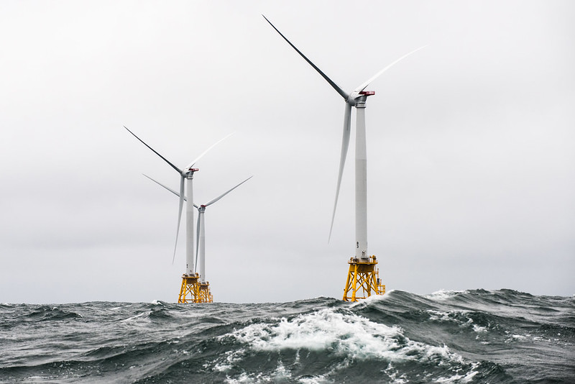
NJ has goal of 11,000 MW from offshore wind by 2040
Notes:
A number of world’s countries have demonstrated they can switch to 100% wind and solar. Read “NJ goal of 3500MW….”In fact, I read those offshore sites have potential for further future expansion by 3 or 4 times the wind power.

Slide 13
World Solar PV Installations
1980 – 2019
Gigawatts (Cumulative)
2019
Data: Earth Policy Institute/BP, Statistical Review of World Energy June 2014 (London: 2014); Bloomberg New Energy Finance
Notes:
ID #3733.G - Can be used in noncommercial online and TV broadcasts of your presentation, but not modified.
This exponential curve is even steeper than the one for wind and rising even faster, …
DESCRIPTION: Graph showing the worldwide growth of solar PV installations in gigawatts, 1980 - 2019
ADDITIONAL TALKING POINTS:
Solar capacity has grown exponentially in the past decade.
Solar technology has been around since the 1970s, but its capacity has grown significantly in recent years, driven by falling costs, continued government support, and technological innovation. There were more renewable solar installations in 2019 than fossil fuel and nuclear power additions combined, which occurred for the fifth year in a row. Solar energy accounted for 57 percent of this new renewable capacity.[1*]
Major greenhouse gas emitters like China, the United States, and India are taking the lead in installing large-scale solar photovoltaics (PV).[1*]
By the end of 2019, at least 39 countries had 1 GW or more of solar capacity, up from 31 in 2018.[1*]
Off-grid solar systems provide rural and off-grid communities with access to electricity. The market for off-grid solar systems grew 13 percent in 2019 – the highest growth of the past five years – with sales totaling 35 million units, up from 31 million units in 2018.[1*]
The cost of solar has dropped significantly in recent decades and the technology has tremendous potential to become even cheaper and more widespread in the future.
Globally, the cost of solar PV has fallen by 99 percent over the last four decades.[2*]
Solar prices have fallen to the point of cost competitiveness with conventional generation technologies (fossil fuels), even without government subsidies.[3*]
In a single hour, the Earth receives more solar energy than humans use in a full year.[4*] It’s just a matter of harnessing what we need.
In 2017, the average solar panel converted 17 percent of all solar energy to usable electricity. Projections show this conversion efficiency could grow to roughly 25 percent by 2027.[5*]
The US continues to ramp up solar investment and installations.
In 2019, solar accounted for nearly 40 percent of all new electricity capacity added in the US – the largest annual share in the industry’s history. The US market installed 13.3 GW of solar PV, which is a 23 percent increase from 2018.[6*]
US solar capacity now exceeds 76 GW, up 7,600 percent from just 1 GW at the end of 2009. Solar capacity is projected to more than double over the next five years, with annual installations reaching 20.4 GW in 2021.[6*]
Solar markets worldwide are blossoming
The Chilean government and the country's four largest electric utility companies reached a voluntary agreement to phase out their coal units by 2040. As solar grows cheaper, coal plants are phased out, and pro-solar government policies continue to be implemented, Chile will accelerate its progress on solar.[7*]
In 2018, Chile’s Installed solar capacity accounted for 9.8 percent of total power generation in 2018, up from only 0.06 percent in 2013.[7*]
Meanwhile, in India, declining costs of solar technologies and government policies that promote foreign investment into Indian markets have driven the rapid adoption of solar PV.[8*]
The pay-as-you-go (PayGo) solar power model allows electricity end-users to pay for their energy consumption and solar technology in small installments – thus avoiding any restrictive up-front investment.[9*]
In 2019, over 1.7 million households were using off-grid PayGo solar products in Sub Saharan Africa and Asia. That number is expected to continue rising rapidly due to its financial accessibility.[10*]
REFERENCES:
[1*] Renewable Energy Policy Network for the 21st Century, “Renewables 2020 Global Status Report,” (2020). https://www.ren21.net/wp-content/uploads/2019/05/gsr_2020_full_report_en.pdf
[2*] David Chandler, “Explaining the plummeting cost of solar power,” MIT News, November 20, 2018. http://news.mit.edu/2018/explaining-dropping-solar-cost-1120
[3*] Lazard, “Lazard's Levelized Cost Of Energy Analysis – Version 13.0,” (November 2019). https://www.lazard.com/media/451086/lazards-levelized-cost-of-energy-version-130-vf.pdf
[4*] Rebecca Harrington, “This incredible fact should get you psyched about solar power,” Business Insider, September 29, 2015. https://www.businessinsider.com/this-is-the-potential-of-solar-power-2015-9
[5*] Ricky Dunbar, “How Efficient Will Solar PV Be In The Future? 10-Year Predictions For The Industry,” Clean Technica, August 15, 2017. https://cleantechnica.com/2017/08/15/efficient-will-solar-pv-future-10-year-predictions-industry/
[6*] Solar Energy Industries Association, “Solar Market Insight Report 2019 Year In Review,” March 17, 2020. https://www.seia.org/research-resources/solar-market-insight-report-2019-year-review
[7*] Mordor Intelligence, “Chile Solar Energy Market – Growth, Trends, And Forecast (2020-2025),” (2019). https://www.mordorintelligence.com/industry-reports/chile-solar-energy-market
[8*] Mordor Intelligence, “India Solar Energy Market – Growth, Trends, And Forecast (2020-2025),” (2019). https://www.mordorintelligence.com/industry-reports/india-solar-energy-market
[9*] Marcus Wiemann and David Lecoque, “The weekend read: A bump in the road for pay-as-you-go solar and self-sustainability,” PV Magazine, October 19, 2019. https://www.pv-magazine.com/2019/10/19/the-weekend-read-a-bump-in-the-road-for-pay-as-you-go-solar-and-self-sustainability/
[10*] Yinka Adegoke, “Africa is facing an electricity crisis – a pay-as-you-go model could solve this problem,” World Economic Forum, July 4, 2019. https://www.weforum.org/agenda/2019/07/pay-as-you-go-africas-solar-energy/
SLIDE SOURCE(S): Bloomberg New Energy Finance

Slide 14
Global Cumulative Storage Capacity
Historical
Gigawatts
Data: Bloomberg New Energy Finance
Notes:
ID #5225.B - Can be used in noncommercial online and TV broadcasts of your presentation, but not modified.
Look at the projections for global storage. Already it’s been increasing dramatically.
DESCRIPTION: Graph showing the recent growth of global cumulative energy storage capacity (in gigawatts) from 2011 to 2021
SLIDE SOURCE(S): Bloomberg New Energy Finance; https://about.bnef.com/blog/global-storage-market-double-six-times-2030/

Slide 15
Global Electric Cars on the Road
Cumulative; Battery and Plug-in Hybrid EVs
Electric Car Stock (Millions)
Data: Global EV Outlook © OECD/IEA 2016
Notes:
ID #4075.F - Can be used in noncommercial online and TV broadcasts of your presentation, but not modified.
… which can cut the global warming pollution there. This is another positive sign.
DESCRIPTION: Graph of the global electric car stock, cumulative of battery and plug-in hybrids between 2010 - 2020
ADDITIONAL TALKING POINTS:
The transportation sector is the second-largest source of global greenhouse gas emissions. To slash emissions and avert catastrophic climate change, we need to transition to cleaner transportation alternatives.[1*]
The danger goes beyond climate impacts: air pollution from vehicle emissions increases the risk of cancer and respiratory issues like asthma and bronchitis.[2*]
Communities of color in the Northeast and Mid-Atlantic United States are exposed to approximately 66 percent more air pollution from vehicles than White residents.[3*]
Globally, vehicle emissions have been linked to approximately 385,000 premature deaths in 2015.[4*]
It took five years to sell the first million electric passenger cars, 17 months to sell the second million, and just six months to get from 3 million to 4 million.[5*]
Though the total volume of electric vehicles (EVs) is still low compared to traditional gas-powered vehicles, EV adoption is skyrocketing – with global sales growing by 46 percent in the first half of 2019, compared to the same period in 2018.[6*]
Much of the recent growth, especially in the US, has been due to the mass production of the Tesla Model 3, which was the highest-selling EV globally in 2019 – making up 13 percent of the global plug-in vehicle market.[7*]
Between 2010–2019, the price of lithium-ion batteries fell by 87 percent, contributing to the increasing competitiveness of EVs.[8*]
When the first mass-market EVs were introduced in 2010, the average cost of a battery pack was $1,000 per kWh. Falling costs meant that by 2017, Tesla’s Model 3 battery packs were only $190 per kWh.[8*], [9*]
f the price of battery packs falls between $125 and $150 per kWh, then EVs are forecast to cost the same or less than internal combustion vehicles. Experts project this will happen by the mid-2020s.[9*]
Some forecasts project the price of battery packs to fall to around $73 per kWh by 2030, as manufacturing methods and materials improve.[9*]
Financial incentives have helped to bridge the gap to make EVs cost-competitive.[10*]
Each of the top-10 countries for electric car registrations has some type of financial incentive in place.[10*]
China, the world’s largest market for electric cars, employs regulatory and purchase incentives that, together, led to nearly 800,000 electric vehicle registrations in 2018.[10*]
Germany, the United Kingdom, Italy, and Romania all offer purchase incentives for electric vehicles. Whereas, the US Norway, and the Netherlands offer tax bonuses, and France offers a combination purchase incentive and scrappage bonus for older non-EVs.[10*]
The US federal government offers a $7,500 consumer tax break for the first 200,000 vehicles an automaker sells. As of the beginning of 2020, only Tesla and General Motors hit the cap.[10*]
With the climate crisis deepening and viable alternatives to gas vehicles increasing, a growing number of countries are planning to phase out combustion engines. Many major auto manufacturers are also developing plans to phase out traditional vehicles and transition to entirely electric lineups.[11*]
Countries like China, India, the UK, and France have all announced plans or intentions to begin phasing out fossil fueled vehicles by 2030 or 2040.[11*]
The trend is similar in the auto manufacturer space:
Daimler (owner of Mercedes-Benz) is accelerating its EV program to have 10 new EVs by 2022.[11*]
All Volvo models introduced in 2019 and after will be hybrid or electric.[11*]
BMW will have 12 new battery electric vehicles (BEVs) and 13 new hybrids by 2025.[11*]
Volkswagen announced that it would attempt to bring 30 or more BEVs to the market by 2025.[11*]
The global electric vehicle market is expected to grow exponentially in the coming years.[12*]
The International Energy Agency projects that by 2030, electric vehicle stock could grow by more than 30 times 2019 levels and reach 245 million electric cars, buses, and trucks.[12*]
The US is projected to see 18.7 million EVs on its roads by 2030, up from 1 million at the end of 2018.[13*]
In 2019, electric buses continued to witness dynamic developments, with about half a million vehicles on the road worldwide.[12*]
REFERENCES:
[1*] International Energy Agency, "CO2 Emissions," last accessed July 2020.
https://www.iea.org/data-and-statistics?country=WORLD&fuel=CO2%20emissions&indicator=CO2%20emissions%20by%20sector
[2*] Union of Concerned Scientists, “Vehicles, Air Pollution, and Human Health,” July 18, 2014. https://www.ucsusa.org/clean-vehicles/vehicles-air-pollution-and-human-health
[3*] Union of Concerned Scientists, “Inequitable Exposure to Air Pollution from Vehicles in the Northeast and Mid-Atlantic,” June 21, 2019. https://www.ucsusa.org/resources/inequitable-exposure-air-pollution-vehicles
[4*] Susan Anenberg, et al., "A global snapshot of the air pollution-related health impacts of transportation sector emissions in 2010 and 2015," (The International Council on Clean Transportation, February 2019). https://theicct.org/publications/health-impacts-transport-emissions-2010-2015
[5*] Bloomberg New Energy Finance, "Cumulative Global EV Sales Hit 4 Million," August 30, 2018. https://about.bnef.com/blog/cumulative-global-ev-sales-hit-4-million/
[6*] Edison Electric Institute, "Electric Vehicle Sales: Facts & Figures," (October 2019). https://www.eei.org/issuesandpolicy/electrictransportation/Documents/FINAL_EV_Sales_Update_Oct2019.pdf
[7*] Zachary Shahan, “Tesla Model 3 Sales = ~4× Nissan LEAF Sales, World’s 2nd Best Selling EV Outside Of China — November EV Sales Report,” CleanTechnica, January 4, 2020.
https://cleantechnica.com/2020/01/04/tesla-model-3-sales-4x-nissan-leaf-sales-worlds-2nd-best-selling-ev-outside-of-china-november-ev-sales-report/
[8*] Veronika Henze, "Battery Pack Prices Fall As Market Ramps Up With Market Average At $156/kWh In 2019," Bloomberg New Energy Finance, December 3, 2019. https://about.bnef.com/blog/battery-pack-prices-fall-as-market-ramps-up-with-market-average-at-156-kwh-in-2019
[9*] Union of Concerned Scientists, “Electric Vehicle Batteries: Materials, Cost, Lifespan,” March 9, 2018. https://www.ucsusa.org/clean-vehicles/electric-vehicles/electric-cars-battery-life-materials-cost
[10*] Volkswagen Aktiengesellschaft, “How electric car incentives around the world work,” May 28, 2019. https://www.volkswagenag.com/en/news/stories/2019/05/how-electric-car-incentives-around-the-world-work.html
[11*] David Roberts, “The world’s largest car market just announced an imminent end to gas and diesel cars,” Vox, September 13, 2017. https://www.vox.com/energy-and-environment/2017/9/13/16293258/ev-revolution
[12*] International Energy Agency, “Global EV Outlook 2020,” June 2020. https://www.iea.org/reports/global-ev-outlook-2020
[13*] Adam Cooper and Kellen Schefter, “Electric Vehicle Sales Forecast and the Charging Infrastructure Required Through 2030,” The Edison Foundation Institute for Electric Innovation and the Edison Electric Institute, November 30, 2018. https://www.edisonfoundation.net/-/media/Files/IEI/publications/IEI_EEI-EV-Forecast-Report_Nov2018.ashx
SLIDE SOURCE(S): https://www.iea.org/reports/global-ev-outlook-2019; https://data.bloomberglp.com/promo/sites/12/678001-BNEF_2020-04-22-ExecutiveFactbook.pdf?link=cta-text

Slide 16
Cost of Clean Energy Technologies in the U.S.
Residential PV
Utility-scale PV
Wind
EV Batteries
LED Lightbulbs
- 55%
- 75%
- 71%
- 79%
- 94%
Data: Natural Resources Defense Council
Notes:
The cost of all these things is rapidly dropping:
Residential (rooftop ) solar
Utility solar
Wind
EV Batteries
LED bulbs
ID #5574 - Can be used in noncommercial online and TV broadcasts of your presentation, but not modified.
DESCRIPTION: A graph displaying the cost decreases of clean energy technology in the U.S. from 2008-2017
ADDITIONAL TALKING POINTS: Between 2008 and 2016, utility-scale solar photovoltaic (PV) project installation costs dropped by 71 percent, while costs for community and rooftop solar decreased by 55 percent. The installation of these small-scale solar projects increased by more than 2,000 percent from 2008 to 2016. Wind capacity in the US reached 89 gigawatts in 2017, an increase of 64 gigawatts since 2008. The 2017 total wind capacity in the US could power upwards of 25 million households. After 2017, there are now more than 750,000 electric vehicles on US roads, with 195,000 being bought in 2017 alone. Lithium-ion battery costs have fallen by 79 percent since 2008, assisting significantly in the expansion of the EV market.*
REFERENCES:
* Natural Resources Defense Fund, "Revolution Now: The Future Is Here For Clean Energy Technology," (2018). https://www.nrdc.org/revolution-now

Slide 17
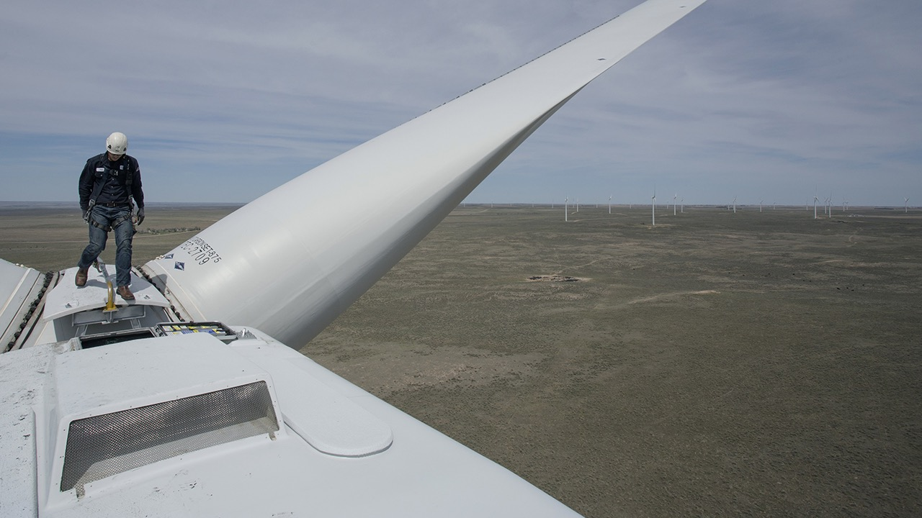
“Solar installer”
is forecast to be the
fastest-growing job
category in the U.S.
through 2026, and
“wind turbine service technician” is second.
Colorado Highlands Wind Farm,
Fleming, Colorado
Photo © 2016 Matthew Staver/Bloomberg via Getty Images
Data: U.S. Bureau of Labor Statistics via Bloomberg
Notes:
ID #4680.C - May not be modified or used in presentations that are recorded, streamed, or broadcast.
The second fastest growing job is wind turbine technician. This is the part of the economy where the millions of new jobs are coming from. This is where we can get sustainable economic growth for the future and put so many people to work.
DESCRIPTION: Text about the future growth of US solar installers and wind turbine service technician jobs and photo of a wind technician walking on a turbine at the Colorado Highlands Wind Farm in Fleming, Colorado, United States, May 5, 2016
ADDITIONAL TALKING POINTS:
The renewable energy sector puts millions to work – and opportunities are growing fast.[1*]
According to International Renewable Energy Agency (IRENA), the renewable energy industry employed 11 million people worldwide in 2018, adding 700,000 jobs from 2017.[2*]
As of 2018, solar remains the largest employer with 3.6 million jobs, followed by biofuels (3.1 million), hydropower (2.1 million), and wind (1.2 million).[2*]
China, Brazil, the US, India, and the EU have the most jobs in renewables. China alone accounted for nearly 40 percent of global renewable energy jobs in 2018.[2*]
The transition to renewables isn’t just helping cut climate-changing emissions – it’s also playing a critical role in supporting sustainable development, improving energy access, and promoting gender equity around the world.[2*]
Manufacturing and construction jobs in the US electricity generation industry are expected to keep growing in coming years, particularly for solar and wind projects.[3*]
In 2018, solar and wind were the top two employers in the electricity generation construction industry, providing about 177,000 and 37,000 jobs, respectively. Natural gas ranked third with around 10,000 jobs.[3*]
Between 2013 and 2018, solar employment grew six times faster than the US industry average. During this period, one in every 124 new jobs was a solar job.[4*]
According to Environmental Entrepreneurs (E2)’s Clean Jobs America report, in 2018, clean energy jobs outnumbered fossil fuel jobs in the US nearly three to one.[5*]
“Solar installer” is projected to be the fastest-growing job in the US through 2026, and “wind turbine service technician” is second, according to the US Bureau of Labor Statistics.[6*]
Energy efficiency is not only an essential tool for reducing emissions – it’s also an engine for job creation and greater productivity.[3*]
The International Energy Agency estimates about $240 billion was invested in energy efficiency across buildings, transport, and industry sectors in 2018.[7*]
IRENA projects that in a business-as-usual scenario, energy efficiency would account for 16.2 million jobs in 2030 (almost a quarter of overall global energy sector jobs). However, IRENA also projects that with more ambitious climate action, efficiency could account for more 25 million jobs (nearly 30 percent of energy sector employment).[8*]
In 2018, the US energy efficiency industry put 2.3 million Americans to work. The sector is projected to grow 7.8 percent in 2019, creating thousands more jobs along the way.[3*]
REFERENCES:
[1*] Arcadia Power, “Renewable energy’s job market continues to grow – with no end in sight,” last accessed July 23, 2019. https://www.arcadiapower.com/energy-101/energy-efficiency/renewable-energy-s-job-market-continues-to-grow-with-no-end-in-sight/
[2*] International Renewable Energy Agency, “Renewable Energy and Jobs Annual Review 2019,” (June 2019). https://www.irena.org/-/media/Files/IRENA/Agency/Publication/2019/Jun/IRENA_RE_Jobs_2019-report.pdf
[3*] National Association of State Energy Officials, “The 2019 U.S. Energy & Employment Report,” (2019). pg. 52 Table 18, pg. 66 Figure 42, pg. 69 Figure 45.https://static1.squarespace.com/static/5a98cf80ec4eb7c5cd928c61/t/5c7f3708fa0d6036d7120d8f/1551849054549/USEER+2019+US+Energy+Employment+Report.pdf
[4*] The Solar Foundation, “2018 National Solar Jobs Census” (2019). https://www.thesolarfoundation.org/national/
[5*] Environmental Entrepreneurs, Clean Jobs America 2019, March 13, 2019. https://www.e2.org/reports/clean-jobs-america-2019/
[6*] US Bureau of Labor Statistics, “Fastest Growing Occupations,” last modified January 30, 2018.
https://www.bls.gov/emp/tables/fastest-growing-occupations.htm
[7*] International Energy Agency, World Energy Investment 2019 (2019). https://webstore.iea.org/download/direct/2738?fileName=WEI2019.pdf
[8*] International Renewable Energy Agency, Global Energy Transformation: A roadmap to 2050 (2018). https://www.irena.org/-/media/Files/IRENA/Agency/Publication/2018/Apr/IRENA_Report_GET_2018.pdf

Slide 18
What can I do?
What can WE do together?
Notes:
ID #1630 - Can be used in noncommercial online and TV broadcasts of your presentation, but not modified.
Well, luckily the answer to that question is yes, too, because we have the solutions at hand.
DESCRIPTION: Text slide stating that we have solutions to the climate crisis at hand

Slide 19
Maximum Benefits from IRA for Individuals*
Solar Systems | 30% tax credit
Battery Storage Systems | 30% tax credit
New/Used EVs | $7500/$4000 tax credit
EV Chargers | 30% tax credit
Weatherization | $1600 rebate/tax credit
Heat Pumps | $8000 rebate
Electric Stoves, Heat Pump Dryer | $840 rebate
Heat Pump Water Heaters | $1750 rebate
Breaker Box Upgrades | $4000 rebate
Electrical Wiring | $2500 rebate
Tax Credits for New Home Builders
* Plus applicable state incentives
https://www.rewiringamerica.org/app/ira-calculator

Slide 20
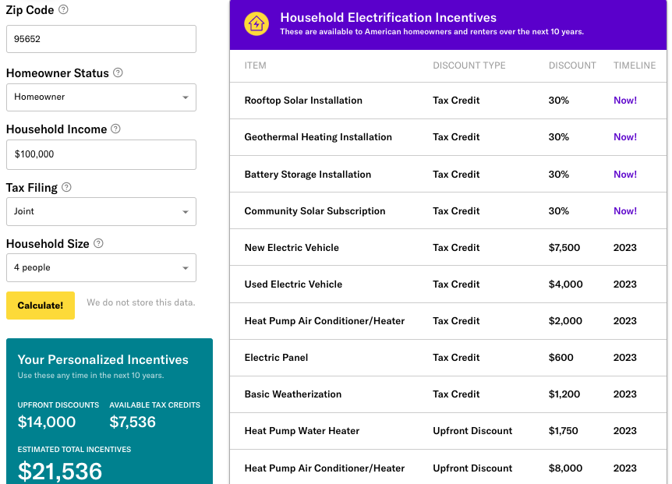
Rewiring America Savings Calculator https://www.rewiringamerica.org/app/ira-calculator
Rebates available up to $14,000 per household, plus tax credits
100% cost coverage for low-income households
  Up to $83,000 per year
50% cost coverage for mid-income households
  $83,000 to $155,000
Notes:
The home electrification and efficiency rebates in the bill include:
heat pumps for heating/air conditioning, water heaters, and clothes dryers
electric stoves;
electric cars;
home weatherization like improved insulation and windows;
rooftop solar and battery storage;
and wiring and breaker box upgrades.
• For low-income: will cover 100% of the costs of these upgrades up to $14,000
- low-income = 80% of median: Monmouth County: $83,000
• For middle-income: will cover 50% of the costs
- $83,000 — $155.000
• See URL above for Rewiring America to calculate your possible rebates and tax credits and when they go into effect

Slide 21
Top 3 Greenhouse Gas (GHG) Emissions Sources in NJ: 87% of All Emissions
  Electricity generation (19%)
  Transportation (42%)
  Residential and commercial buildings (26%)
RedUCE All 3

Slide 22
Switch To Clean Electricity
Install rooftop solar
Subscribe to Community Solar - 21% below NJ Utility (2023 data)
Switch to a 100% clean supplier http://electric.smiller.org
(prices now are much higher than Community Solar)
Notes:
You can switch to 100% clean electricity, AND save money, instead of defaulting to 20% clean electric from JCP&L.
Best investment: If you can SOON, pay cash to install rooftop solar.
OR (same GHG reduction): swtich to 100% clean supplier (spend 10 minutes, selecting vendor at URL)
OR – wait a couple of years for investors to build large array “Community Solar” fields – which should prove to be a GREAT investment for you
CLICK

Slide 23

Carbon Sequestration but No Solar
Tree Cover At High Noon
50 Foot Trees
Notes:
AND/OR – JOIN WITH OTHERS and push for your town to switch ALL residents to 100% renewable Community Choice Electric aggregation. This saves 5 or 10% on electric bill, and has the BIGGEST GHG reduction!

Slide 24

COMMUNITY SOLAR
Clean Energy
Lower Energy Costs
No Panels on Your Property
BPU/Sustainable Jersey Community Solar www.sustainablejersey.com/communitysolar

Slide 25
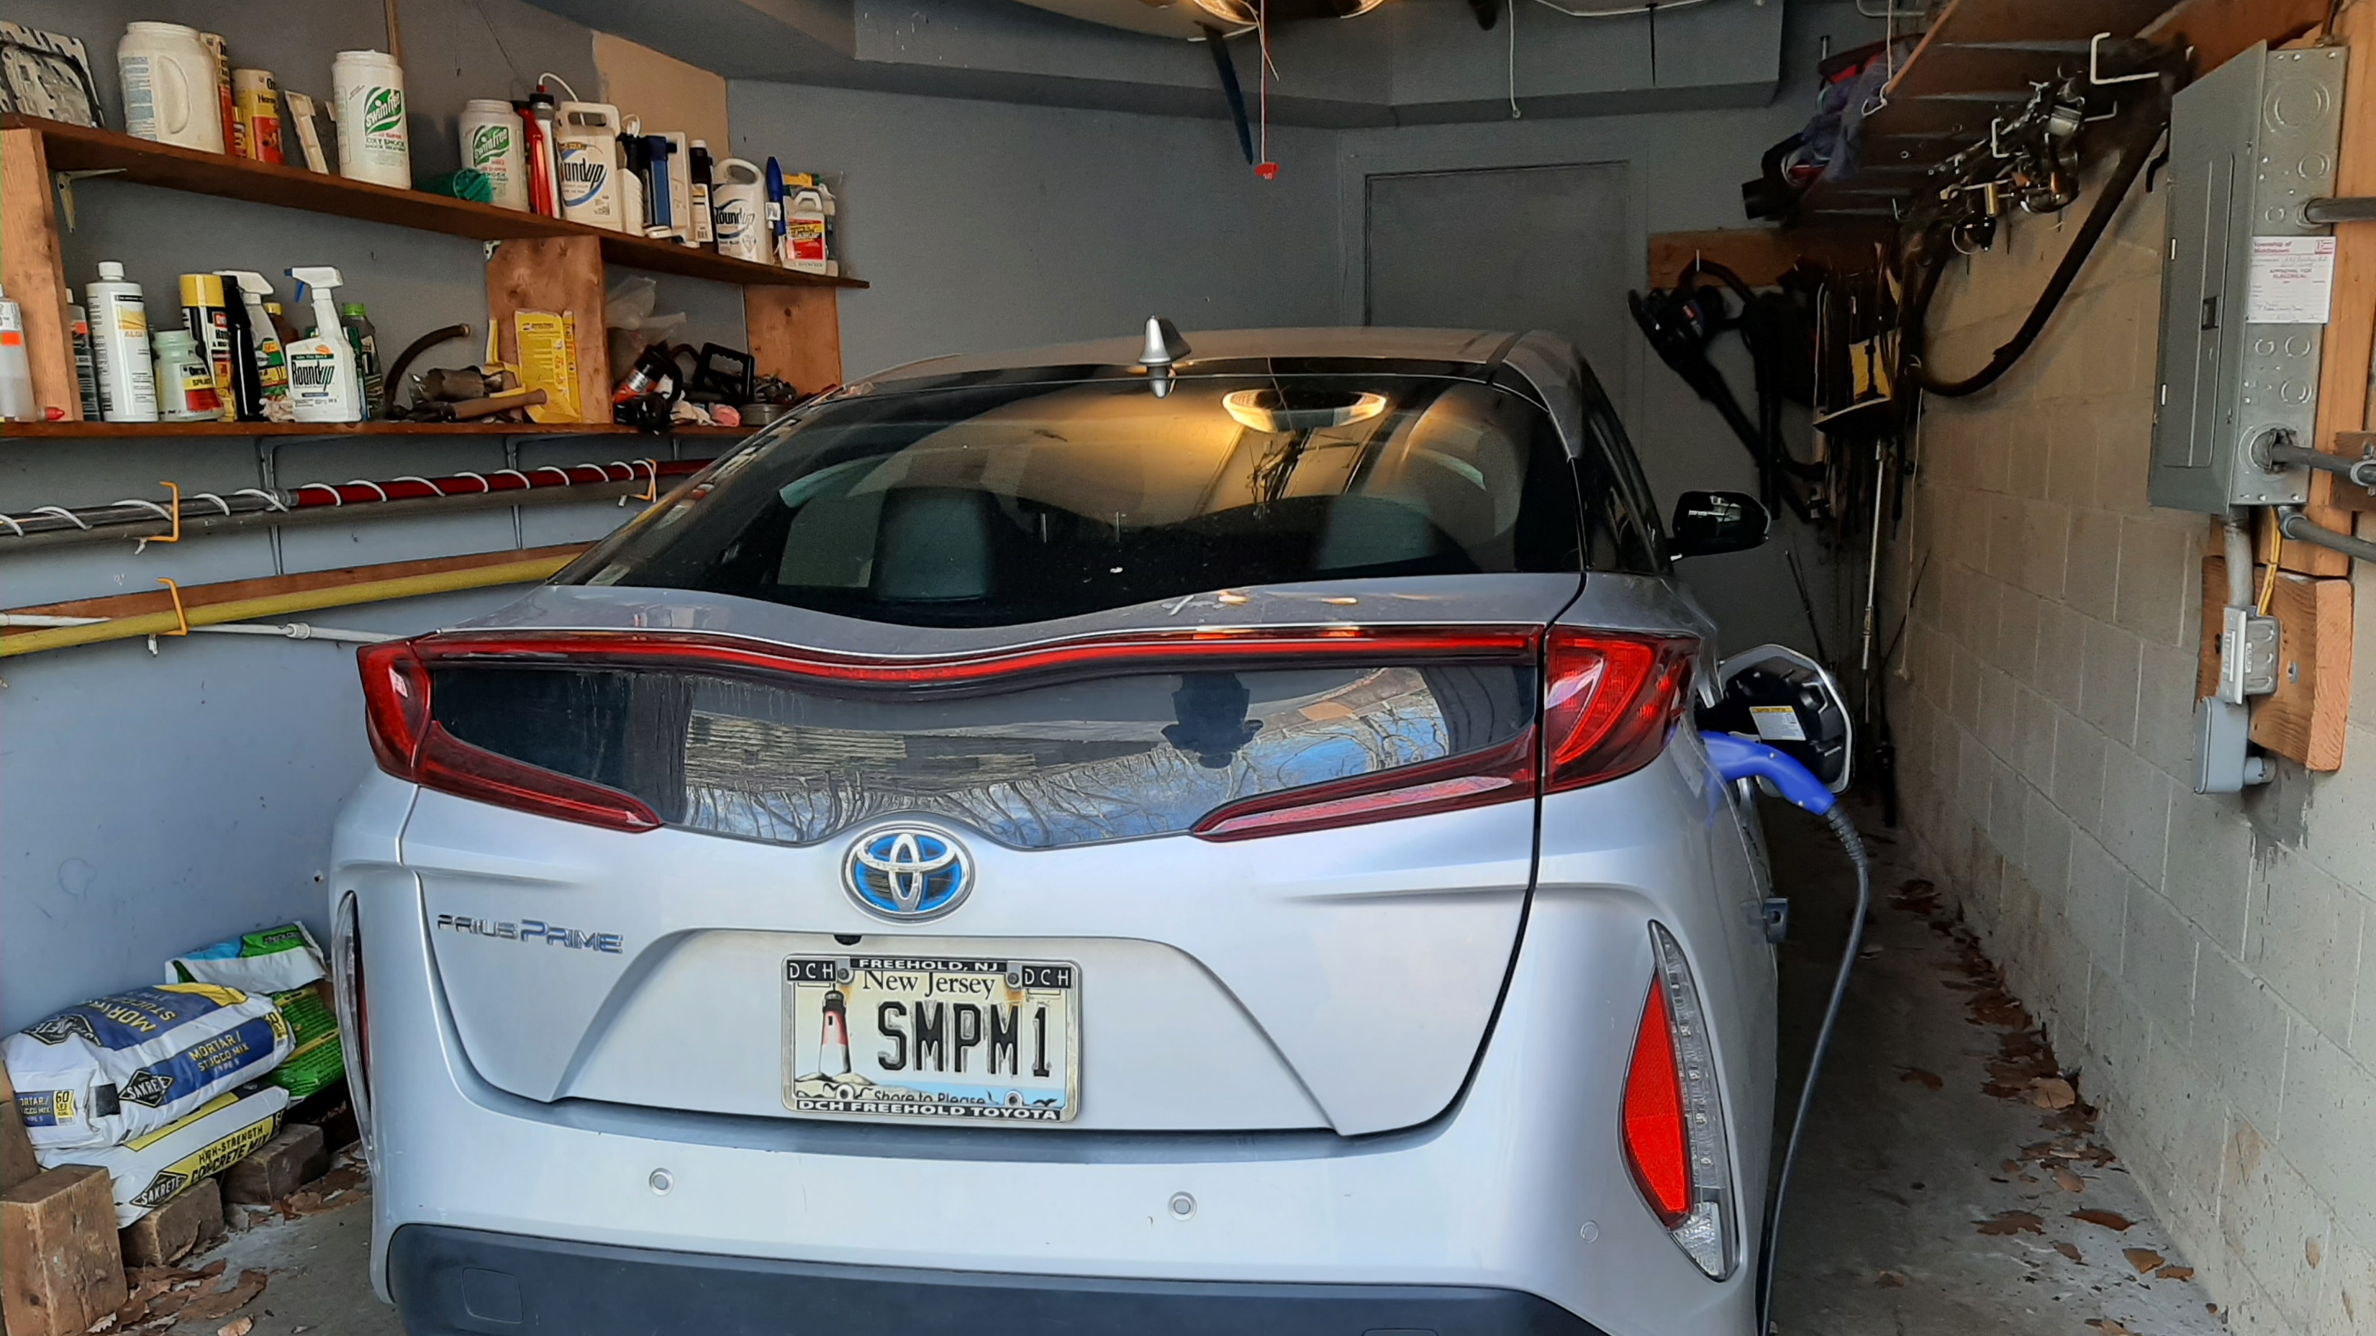
OUR EV – PRIUS PRIME PLUG-IN
Notes:
READ

Slide 26

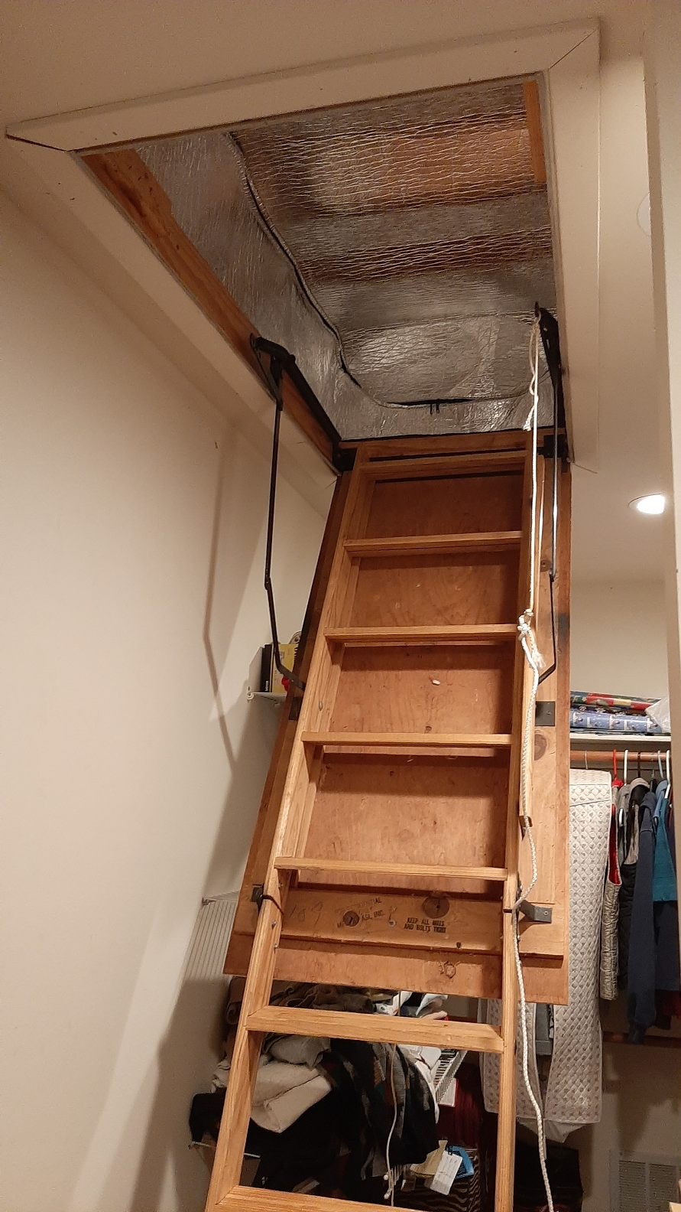
Energy Efficiency – Use Less Energy
Notes:
READ

Slide 27

Space Heating & Cooling w. Electric Heat Pump
Notes:
READ

Slide 28
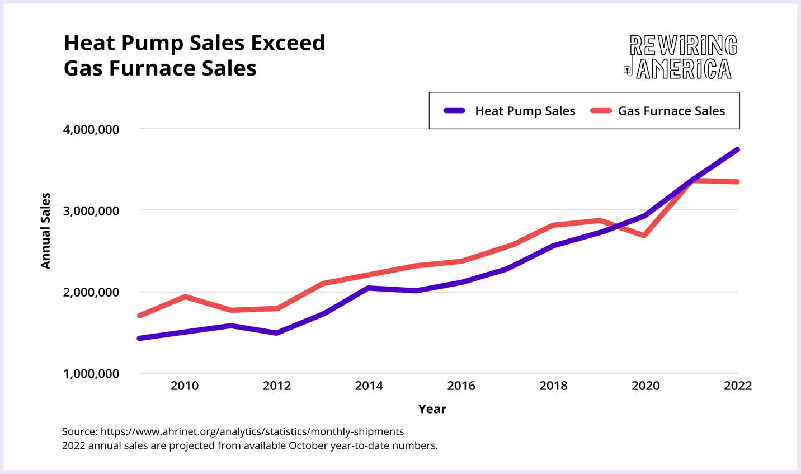

Slide 29
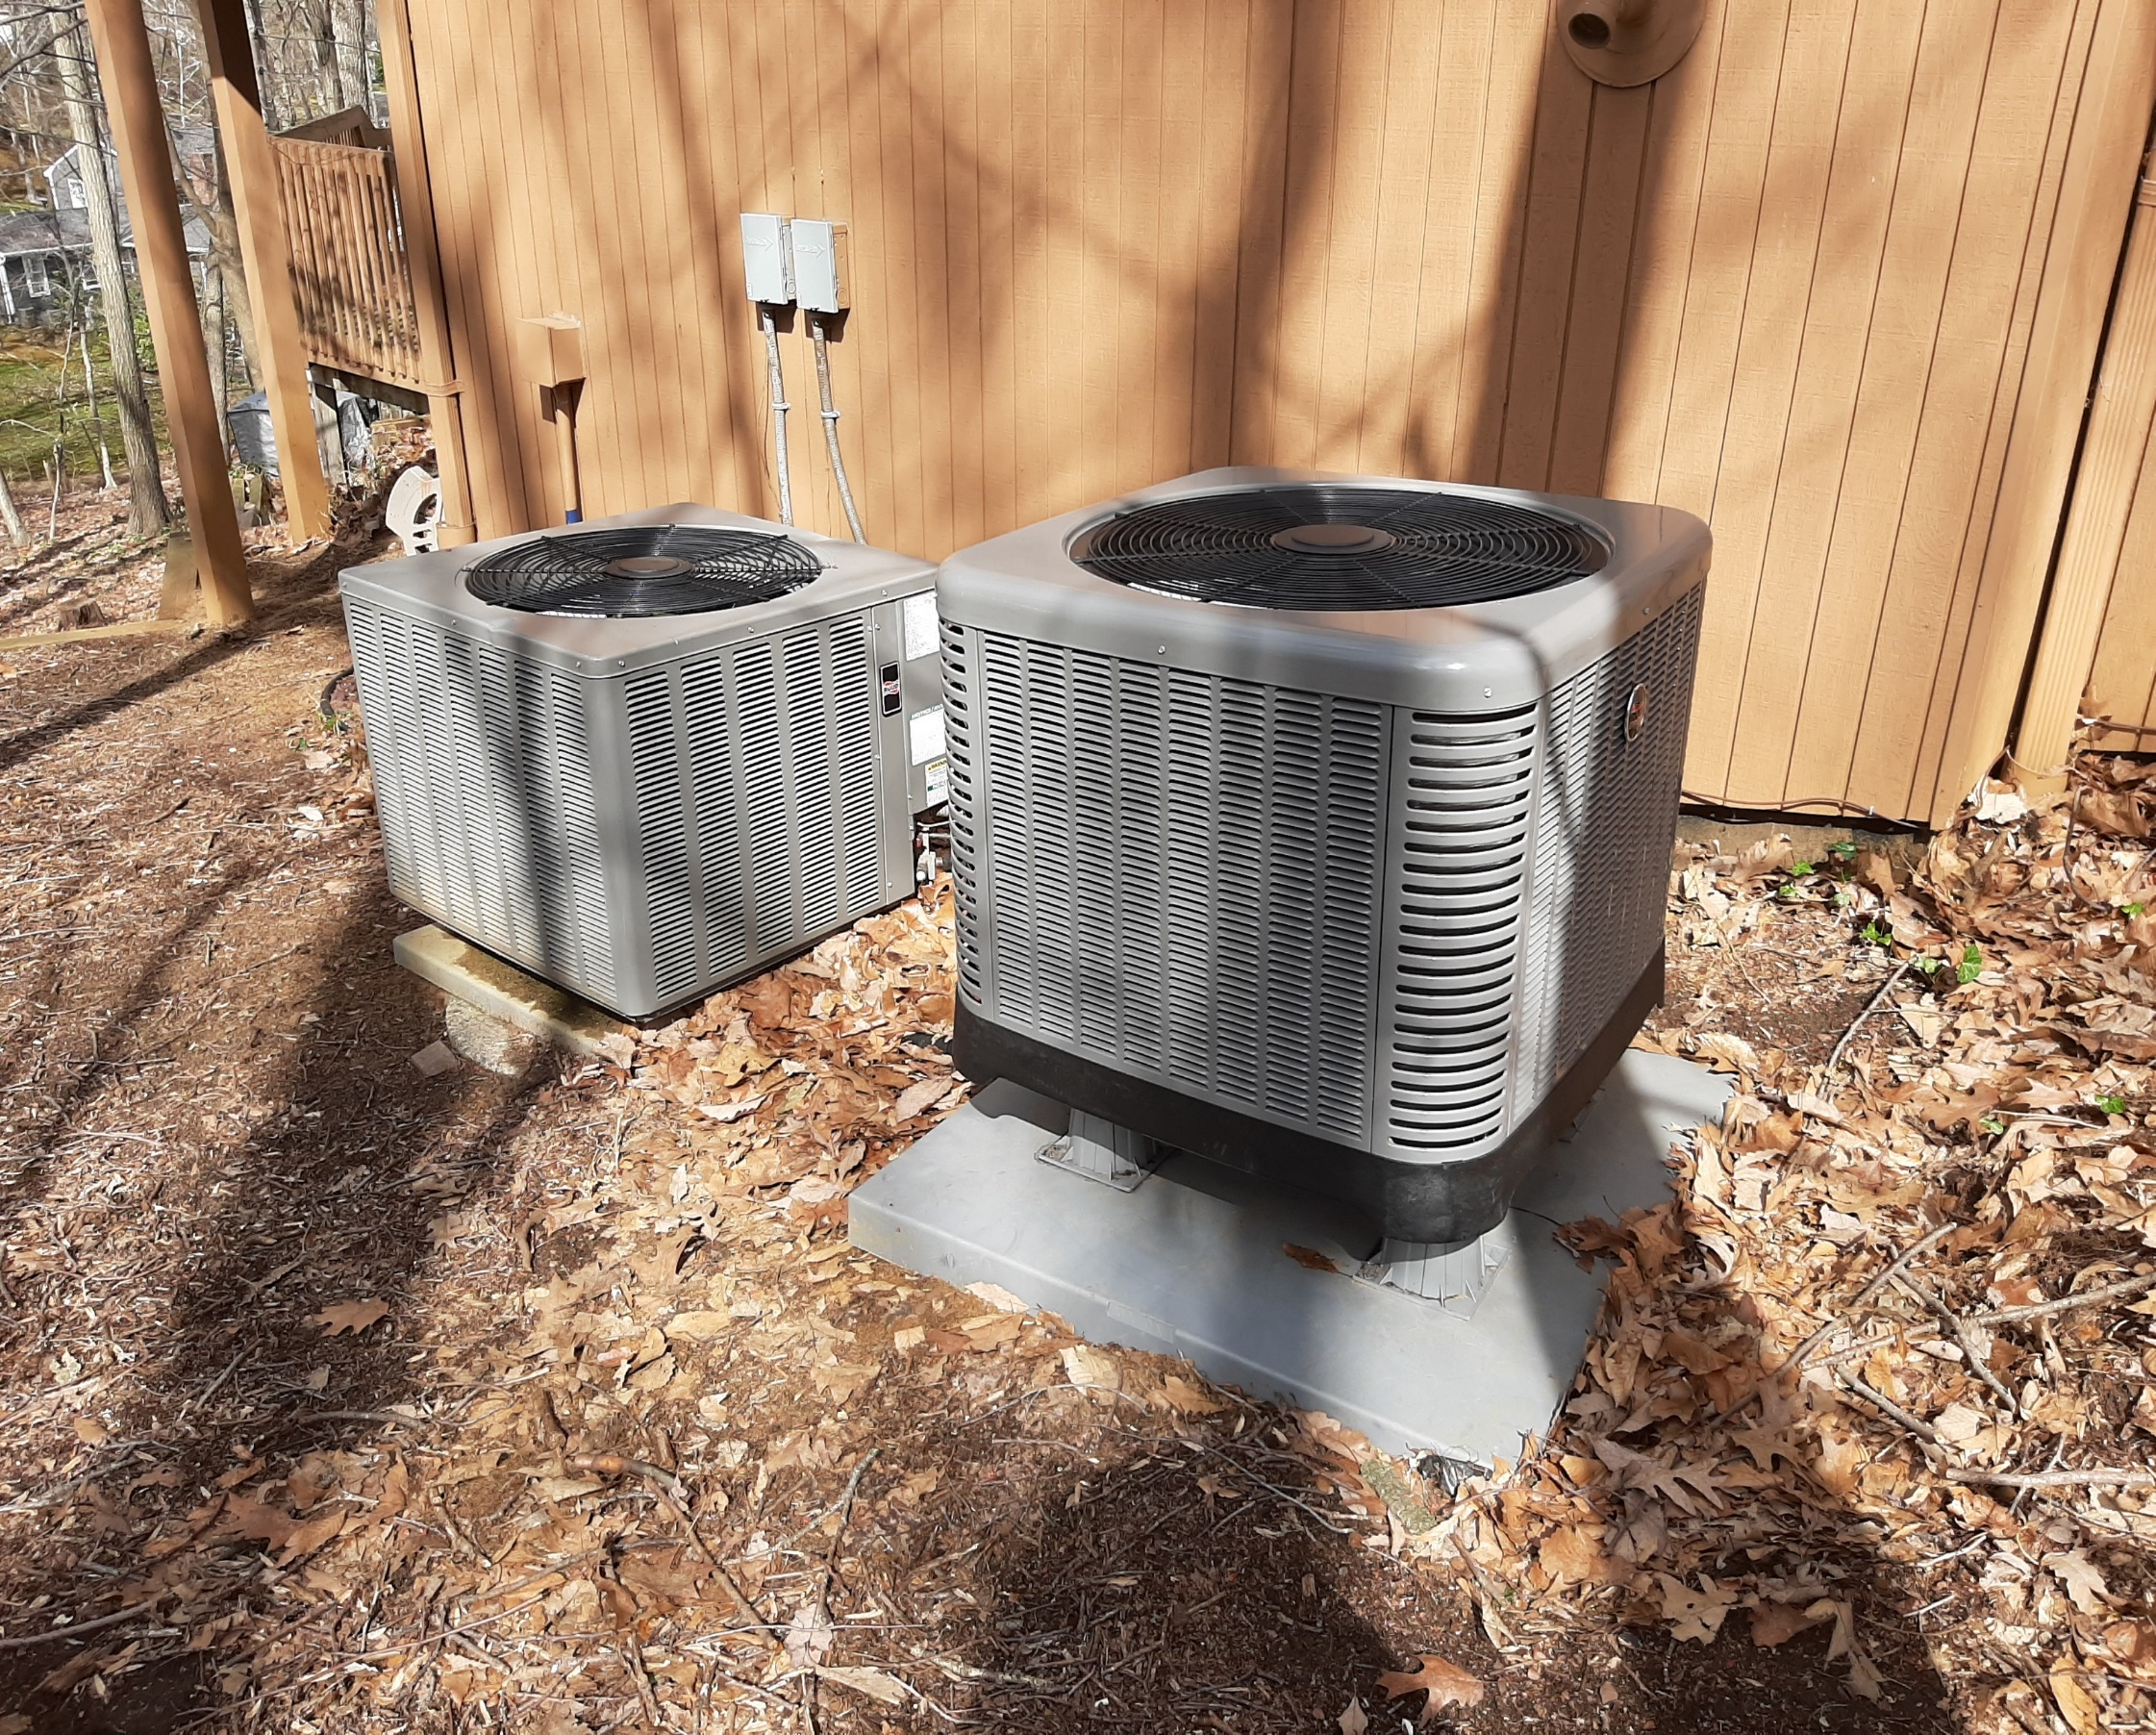
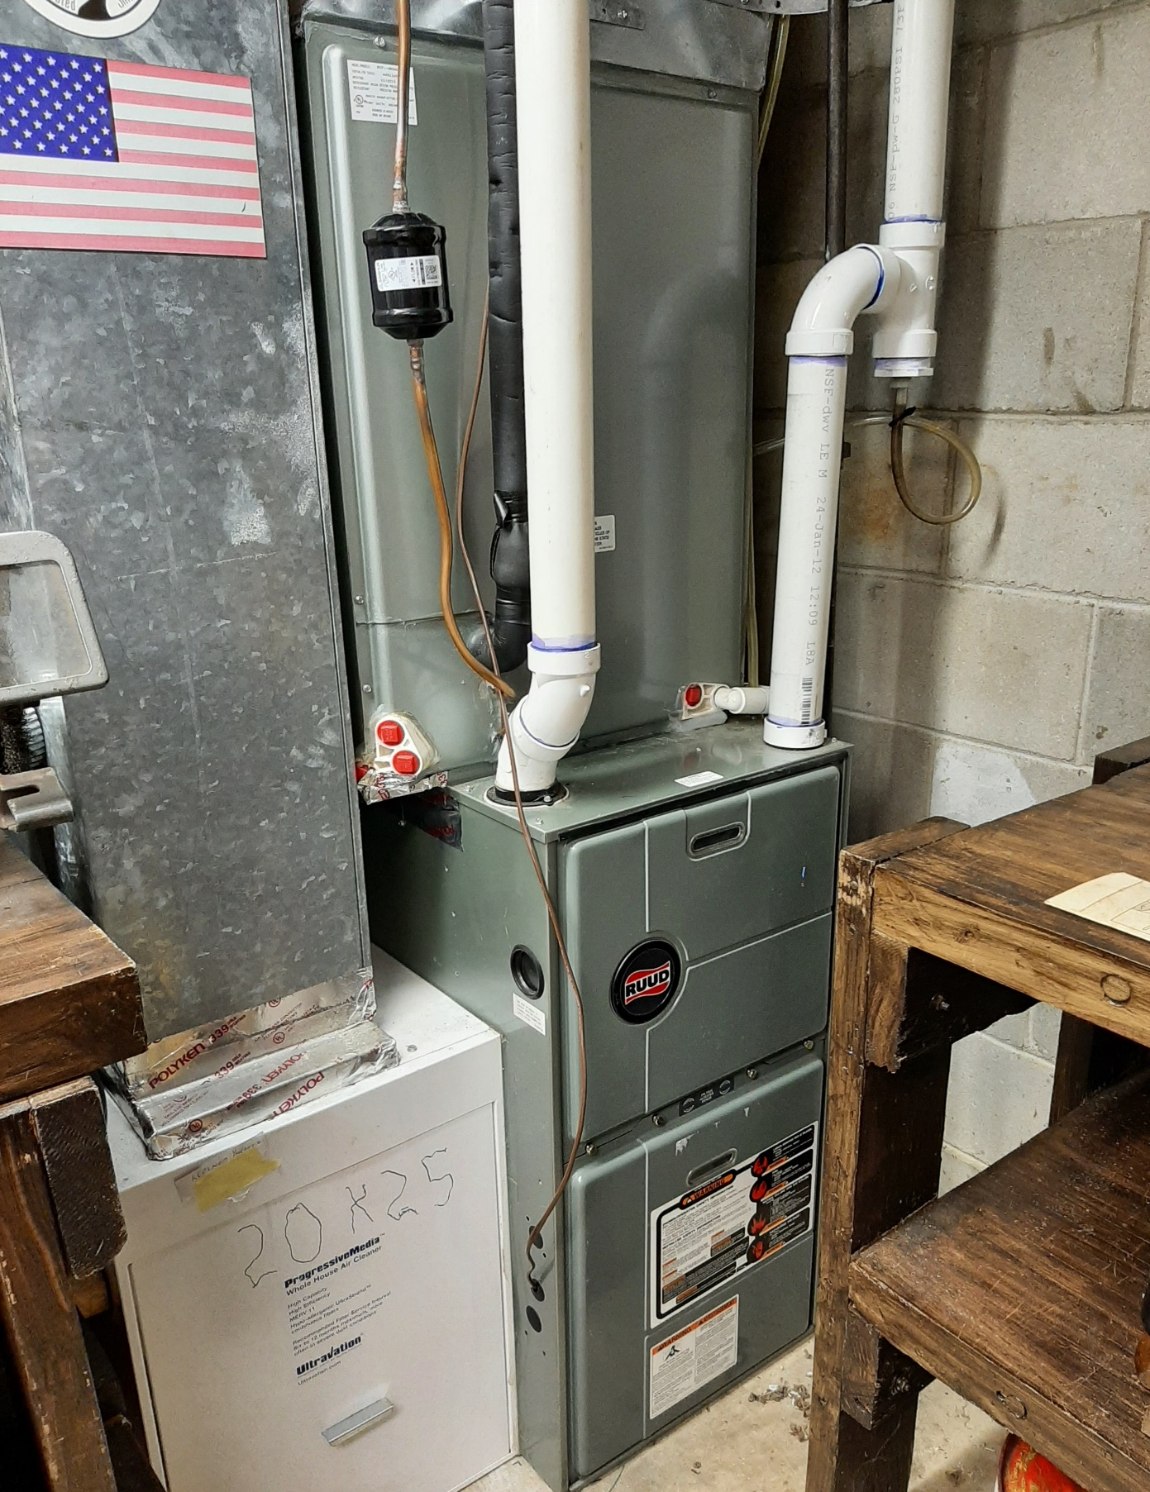
Which one is the heat pump? Gas furnace backup on right
Notes:
READ

Slide 30
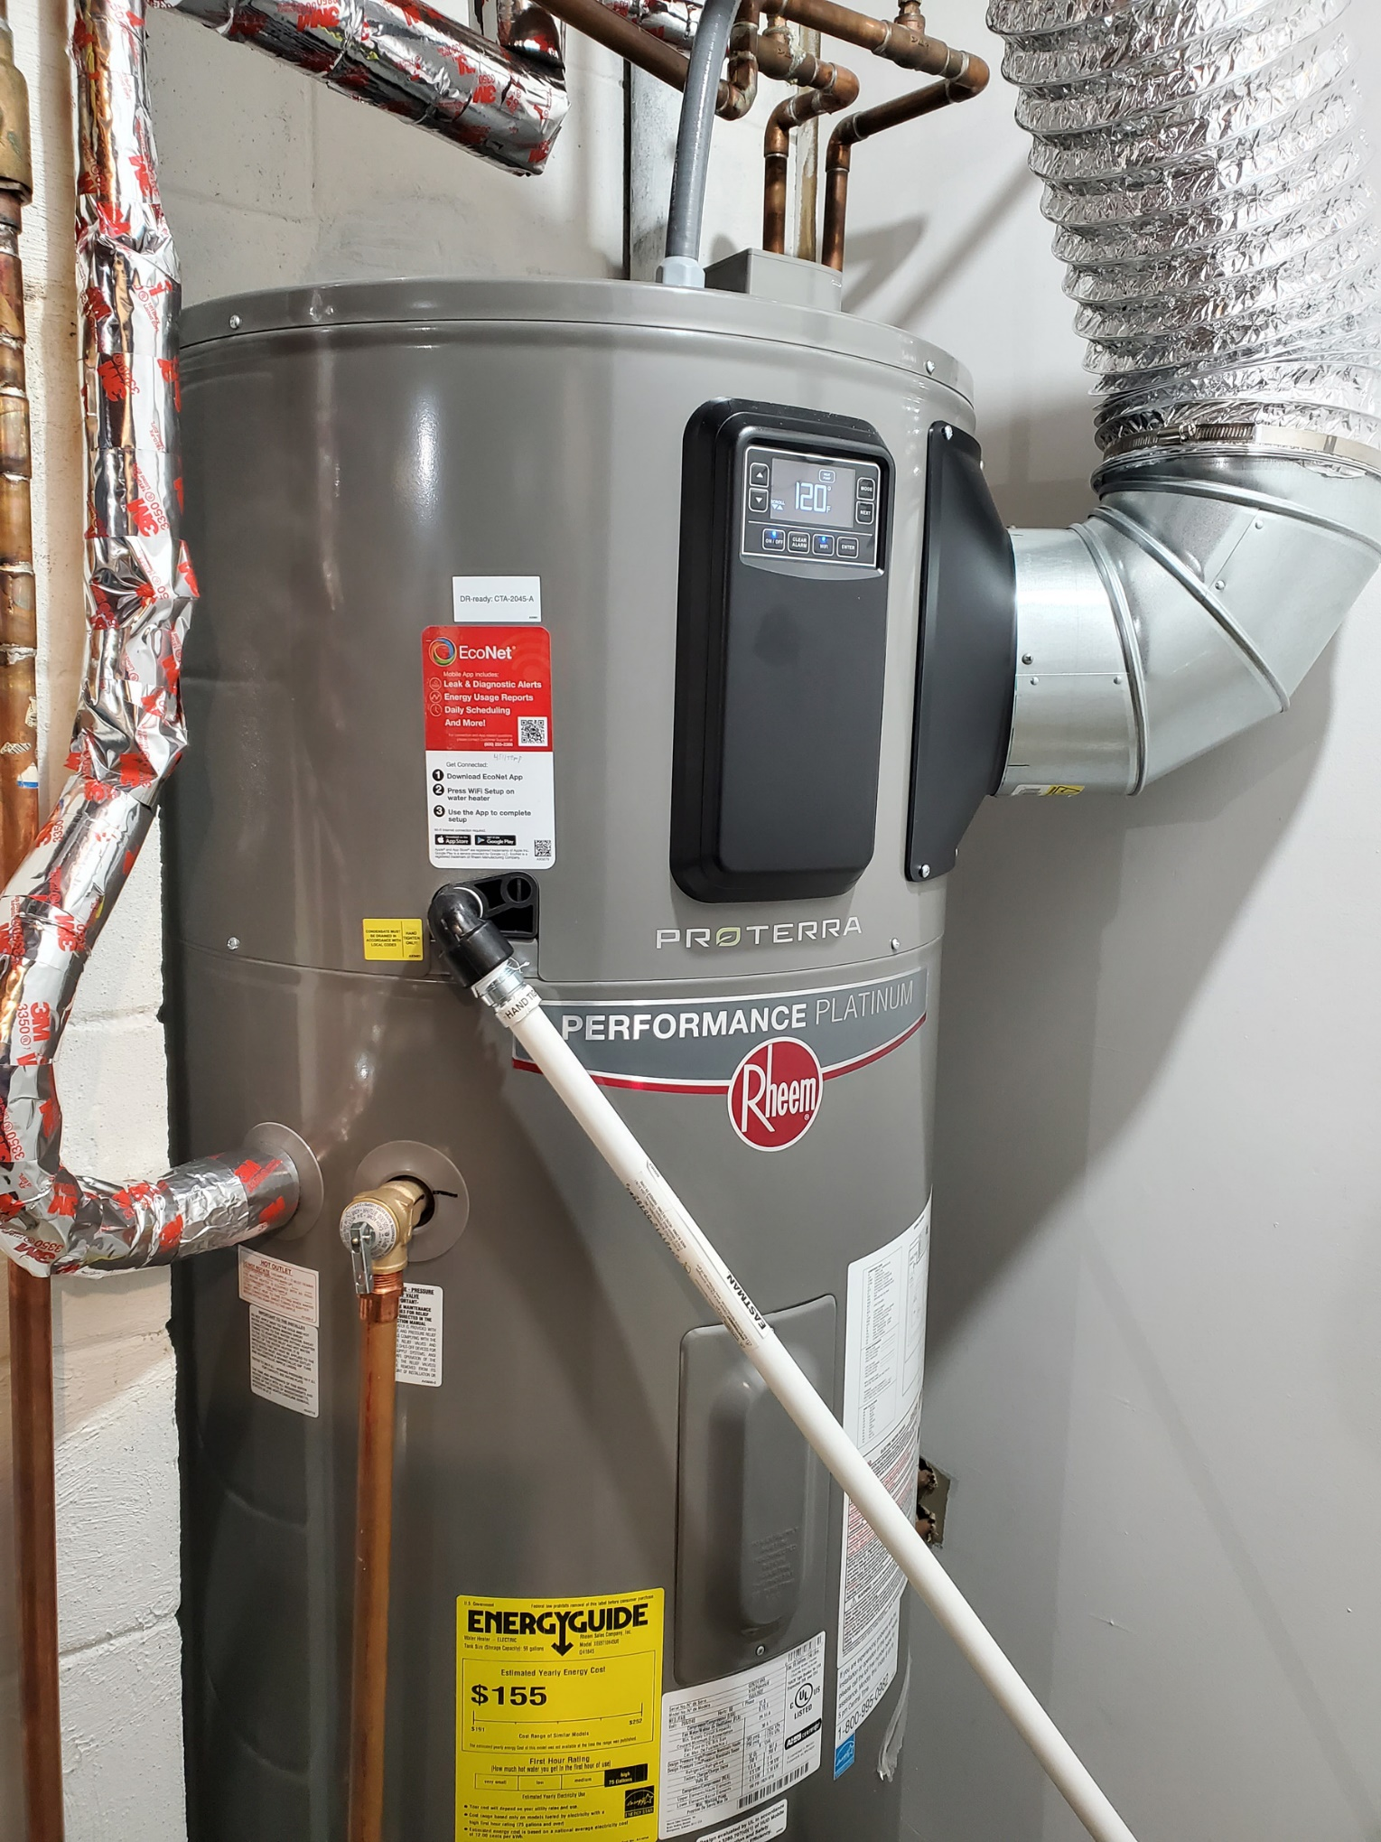
ELECTRIC HEAT PUMP WATER HEATER

Slide 31
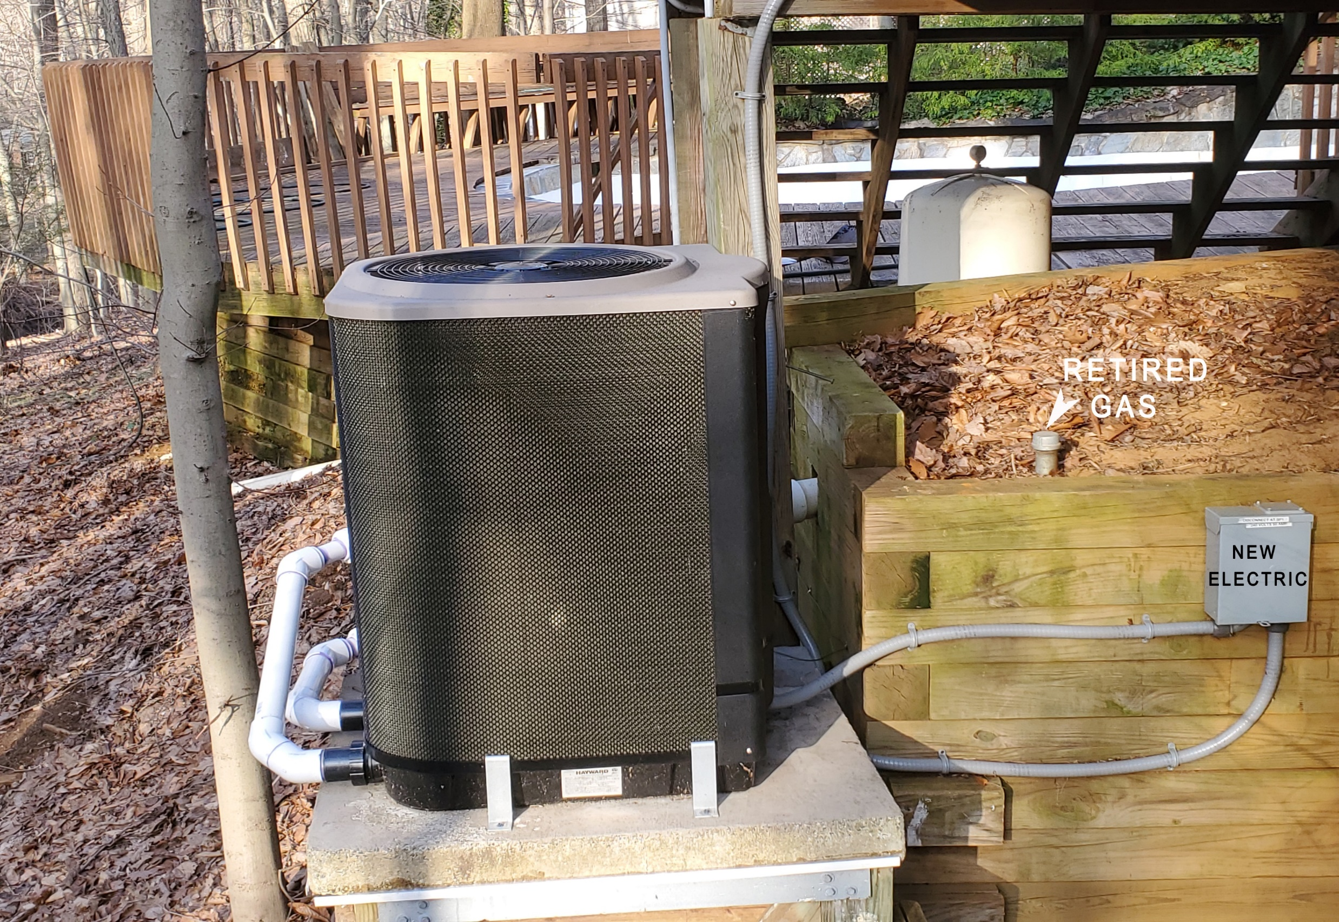
Pool Heater – Electric Heat Pump
Notes:
READ

Slide 32
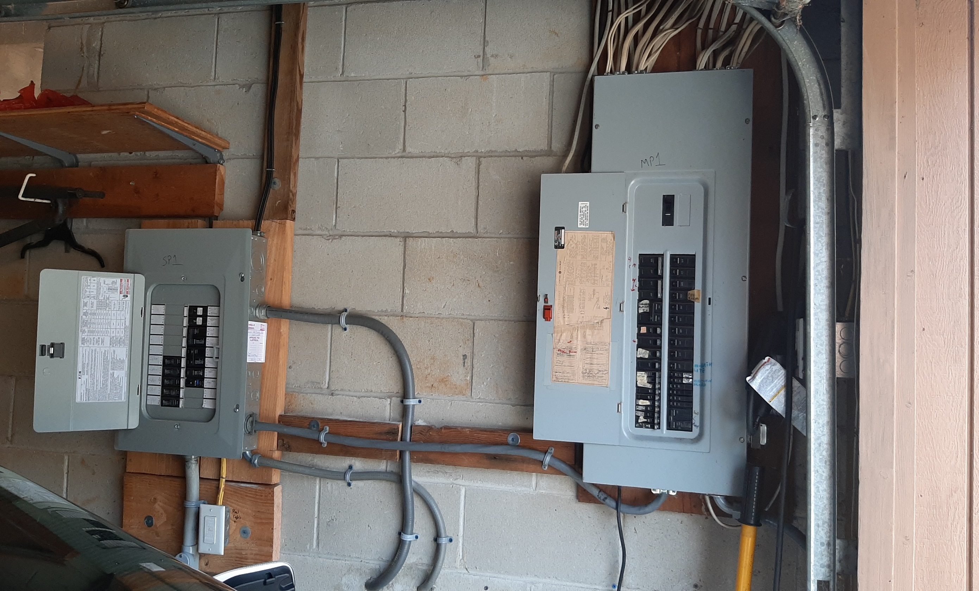
Spare Circuits for Future Electric Appliances
New Box on Left for New/Future
2nd Heat Pump Space Heater/AC
Heat Pump Water Heater
Stove
Dryer
2nd EV
Notes:
READ

Slide 33
Have A Plan For Electrification
Home energy audit is a great starting point
Then weatherize (insulate, seal air leaks)
Have a plan so you’re prepared when your hot water heater or furnace dies
  Which one will you purchase?
  Will your electrical panel support it?

Slide 34
Electric Heat Costs Less, Pollutes Less
2022 ENERGY COSTS
 | ACTUAL with heat pump | CALCULATED (no heat pump) | % CHANGE with heat pump | With Heat Pump
TOTAL Gas + Electric* | $2441 | $3153 | (23%) | Savings
GAS Cost | $394 | $1681 | (77%) | Reduction
ELECTRIC Cost | $2047 | $1472 | 39% | Increase
THERMS Gas Burned | 201 | 1163 | (83%) | Savings
TONS CO₂ Emitted** | 1.2 | 6.8 | (83%) | Savings
* Gas and electric costs include ALL uses for Miller household during year 2022 2202
** Electric is 100% clean

Slide 35
NJ 50 x 30 Building Electrification Team
Organization founded by Steve and Pat Miller in 2021
Advocate with NJ State officials to speed up transition to clean energy and Building Electrification
Educate consumers (residents and businesses) and HVAC staff to embrace electric heat pumps to both heat and cool buildings
Monthly webinar to highlight electrification steps homeowners and vendors have taken
https://climate.smiller.org/50x30/building-electrification/All-heat-pump-webinars.html

Slide 36
New Jersey BE Legislation, etc.
2019 Energy Master Plan
Governor’s Executive Orders
  EO 274 – Reduce GHG emissions 50% by 2030
  EO 315 – 100% clean electricity by 2035
  EO 316 – zero-carbon-emission space heating and cooling systems in 400,000 homes and 20,000 commercial properties and 10% of all LMI properties electrification-ready by 2030
  EO 317 – BPU plan for future of gas utilities to achieve 50x30
S3672 – BPU establish program to require utilities to implement building electrification plans

Slide 37

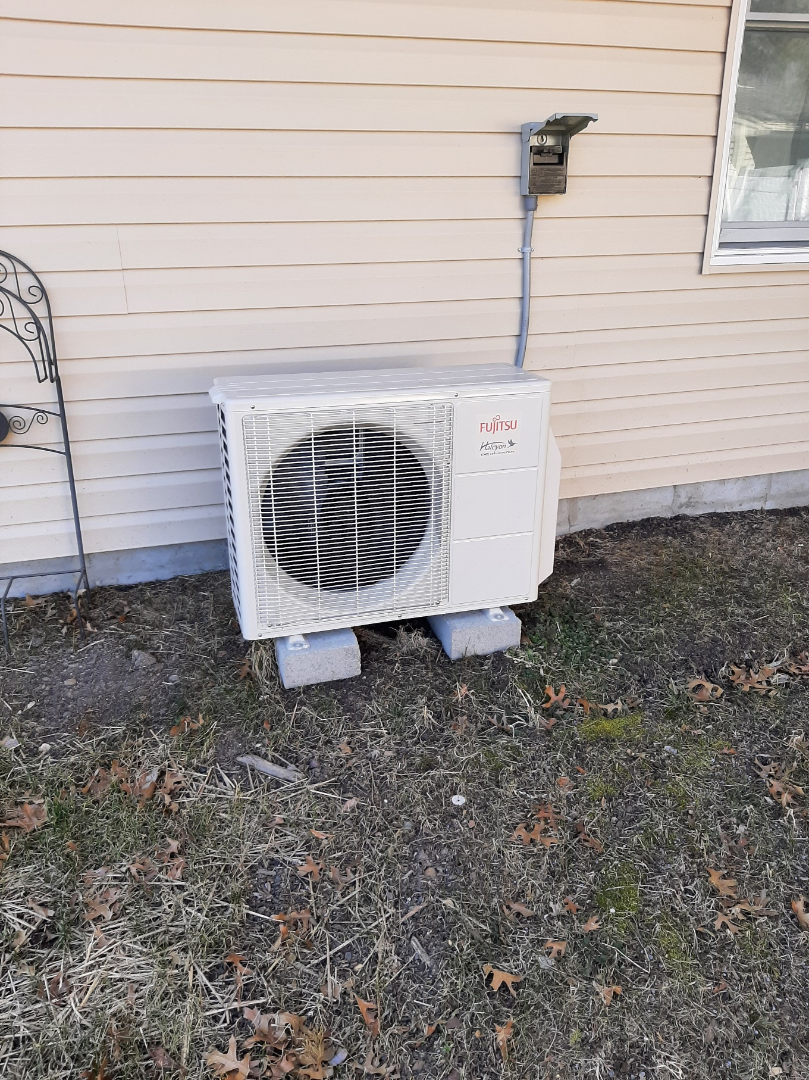
Small Heat Pump for New Addition
Fujitsu AOU12RLFC meets NJ and Federal IRA Act requirements: https://climate.smiller.org/50x30/building-electrification/2023-3-27-science-monday/2023-3-16-revised-specs.docx

Slide 38

INDEX TO ALL BUILDING ELECTRIFICATION
WEBINARS.
The dates/names in GREEN were featured in the March 27 webinar

Slide 39
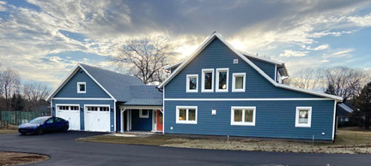
New House Built As Passive House
John And Diane – Webinar 3/16/2023

Slide 40
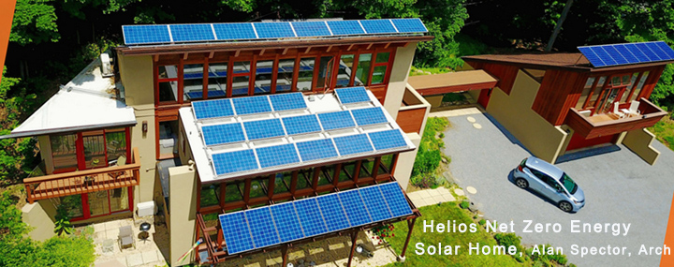
Net Zero Energy Living
Alan Spector
Webinar
3/17/2022
1984 | 1998 | 2010 | 2013 | 2019
Passive Solar House 3200 sq. ft. | Add Solar Hot Water | Add Solar PV Add Hybrid Car | Add 3 Heat Pumps Add EV | Add Community Solar Add 4th Heat Pump Add 2nd EV
23.7 tons CO₂ | 22.3 tons CO₂ | 10.3 tons CO₂ | 6.7 tons CO₂ | 0 tons CO₂

Slide 41
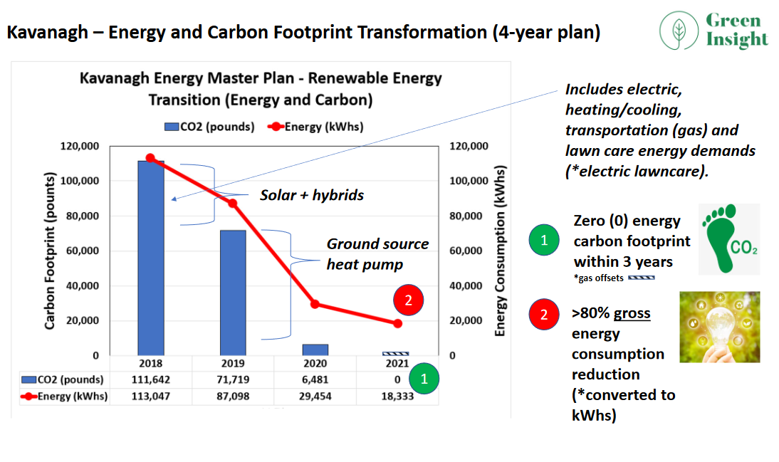
Webinar 12/15/2022

Slide 42
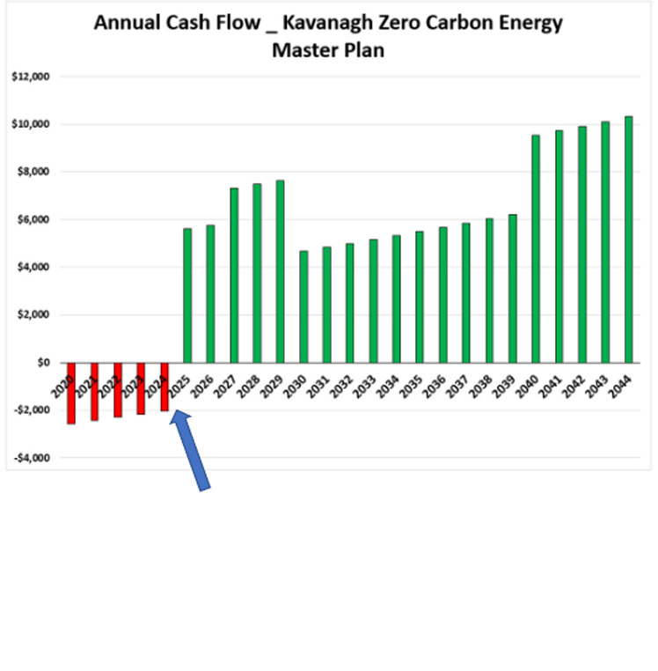

Webinar 12/15/2022
Positive cash flow after 5.5 years
$135k positive cash flow (25 years)

Slide 43
“Zero Carbon Home”, David Green (5400 sq foot house)
Webinar 7/21/2022
 | Payback | Money Saved (yearly) | Carbon Reduction (CO₂ per year)
Heat Pumps | 9.1 years | $2,888 | 20 Tons
Solar Panels | 7.2 years | $5,572 | 14 Tons
Insulation | 0.3 years | $2,923 | 7 Tons
Triple glazed windows * | 4.6 years | $974 | 2 Tons
TOTAL |  | $12,358 | 43 tons
*Investment and cost savings are the additional cost above double-glazed. equivalents.
Replacing windows will not pay for themselves UNLESS use “fit-from-inside” triple-glazed windows

Slide 44
A church is considered commercial. What can a congregation, or any business, do to reach net zero?
Notes:
ID #1630 - Can be used in noncommercial online and TV broadcasts of your presentation, but not modified.
Well, luckily the answer to that question is yes, too, because we have the solutions at hand.
DESCRIPTION: Text slide stating that we have solutions to the climate crisis at hand

Slide 46
Property Upgrades to Lower GHG Emissions 2003-2022
2003 Earth Day tree planting (church + homes)
2004 Energy audit
2005 Programmable thermostats; start replacing bulbs with compact fluorescent
2006 Installed rooftop solar
2008 Community room insulation; installed Energy Star windows; more efficient lighting
2008-2012 Tracked reduction in carbon footprint
2010 Community room A/C
2011 Energy Star refrig + freezer; updated classroom lighting; new insulated classroom roof
2011-2012 Subscribed to 100% wind renewable electricity
2014 Heat pump water heater
2016 Switched to LED in main building
2017 Converted Earth Room flood lights to LED
2021 HVAC heat pumps (6); tankless water heater, classroom lights to LED; reshingled roof
2022 New solar system

Slide 47
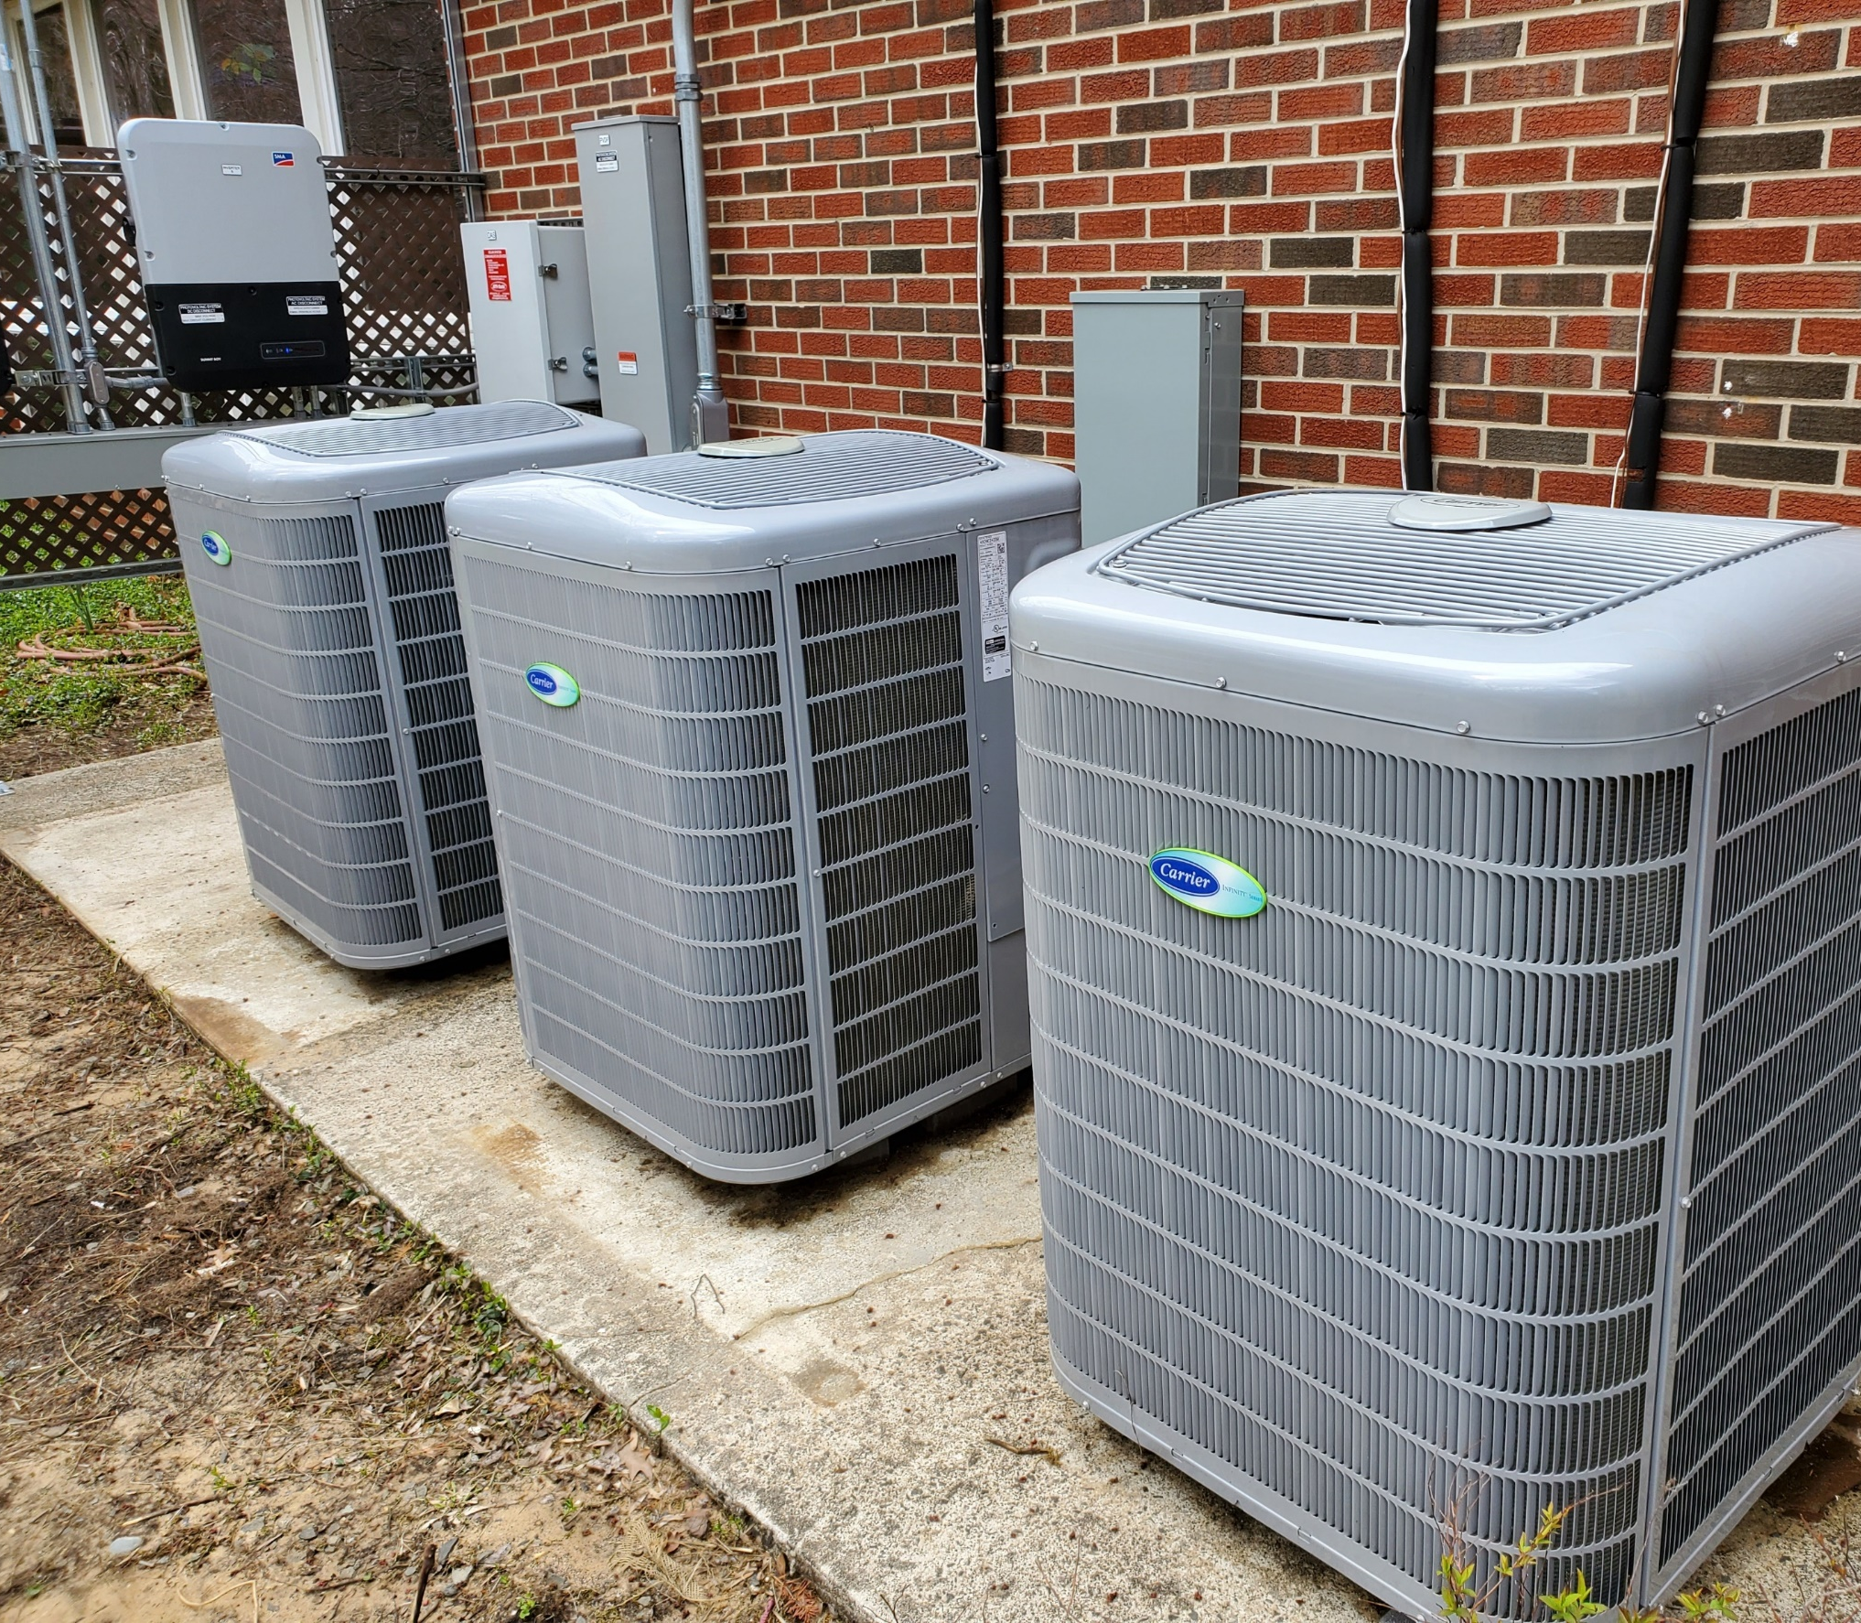
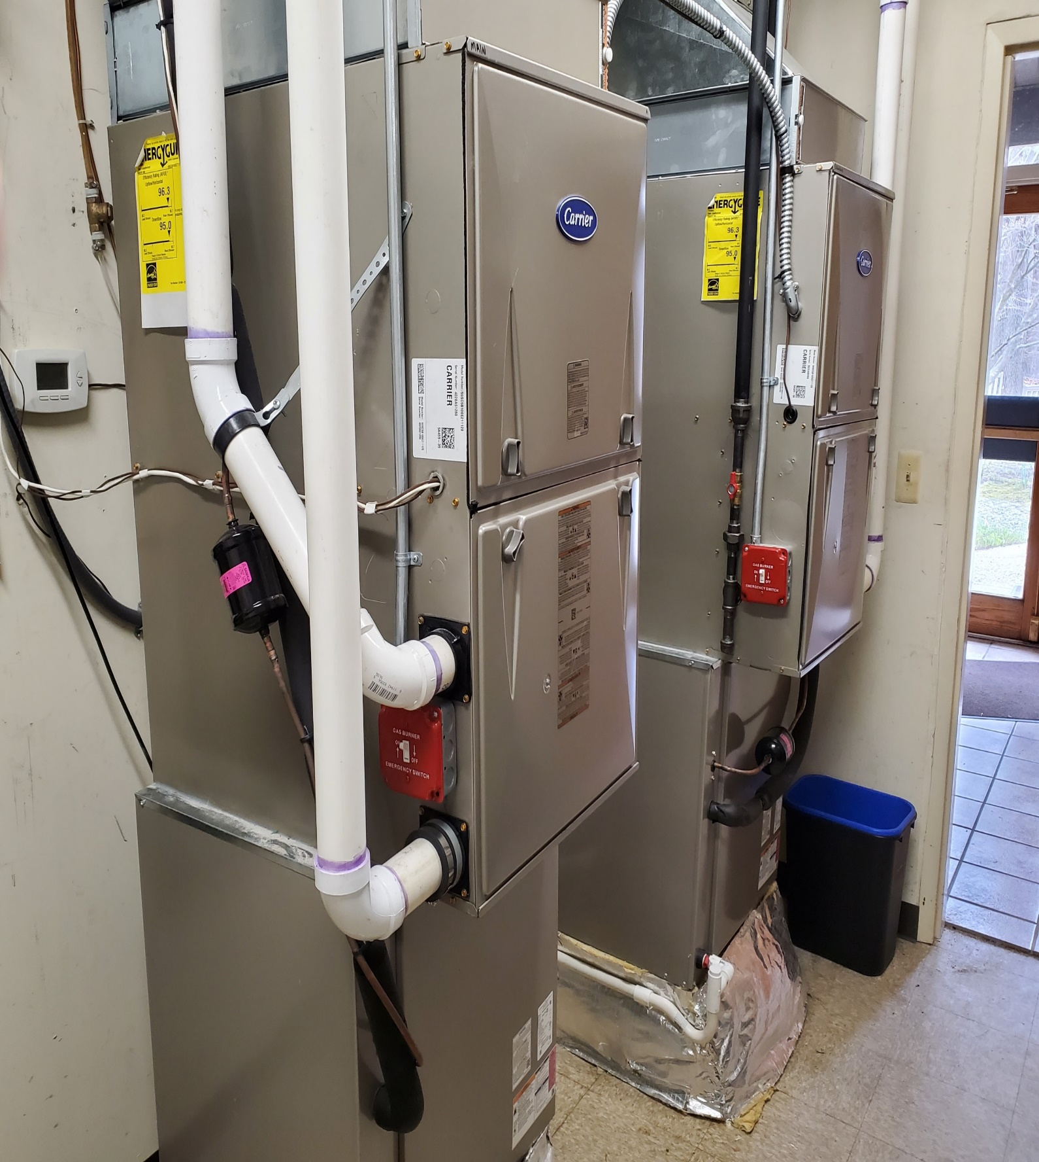
UUCMC 2021 Heat Pumps

Slide 48
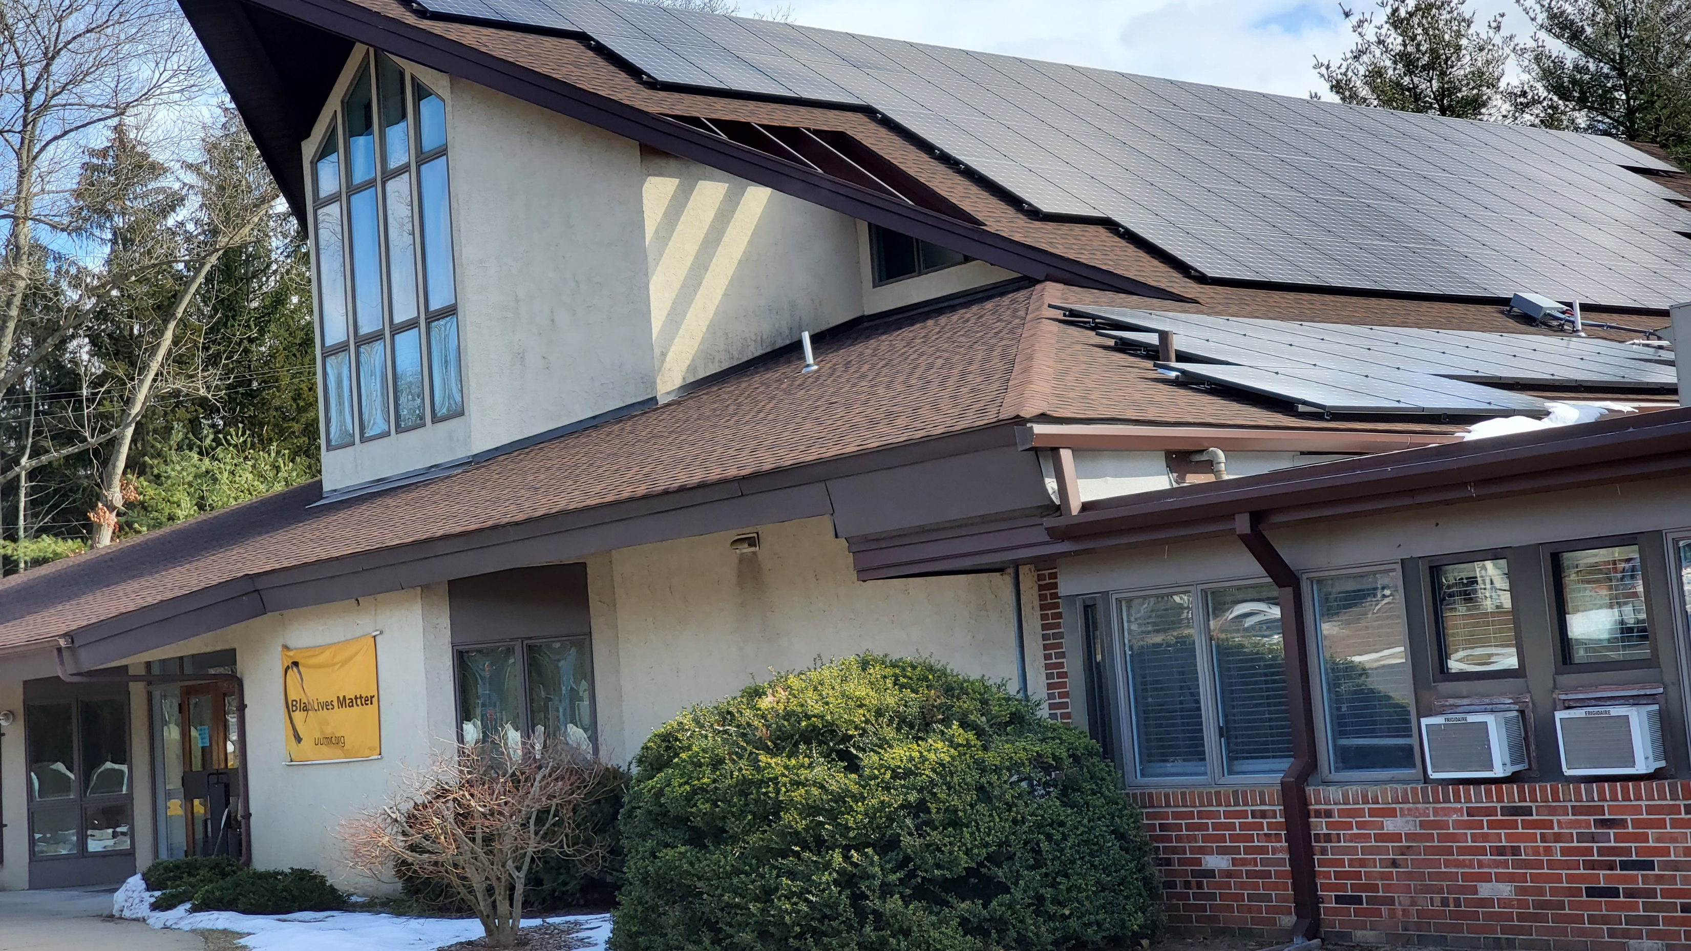
UUCMC 2022 Rooftop Solar
4 x Capacity of Old System

Slide 49
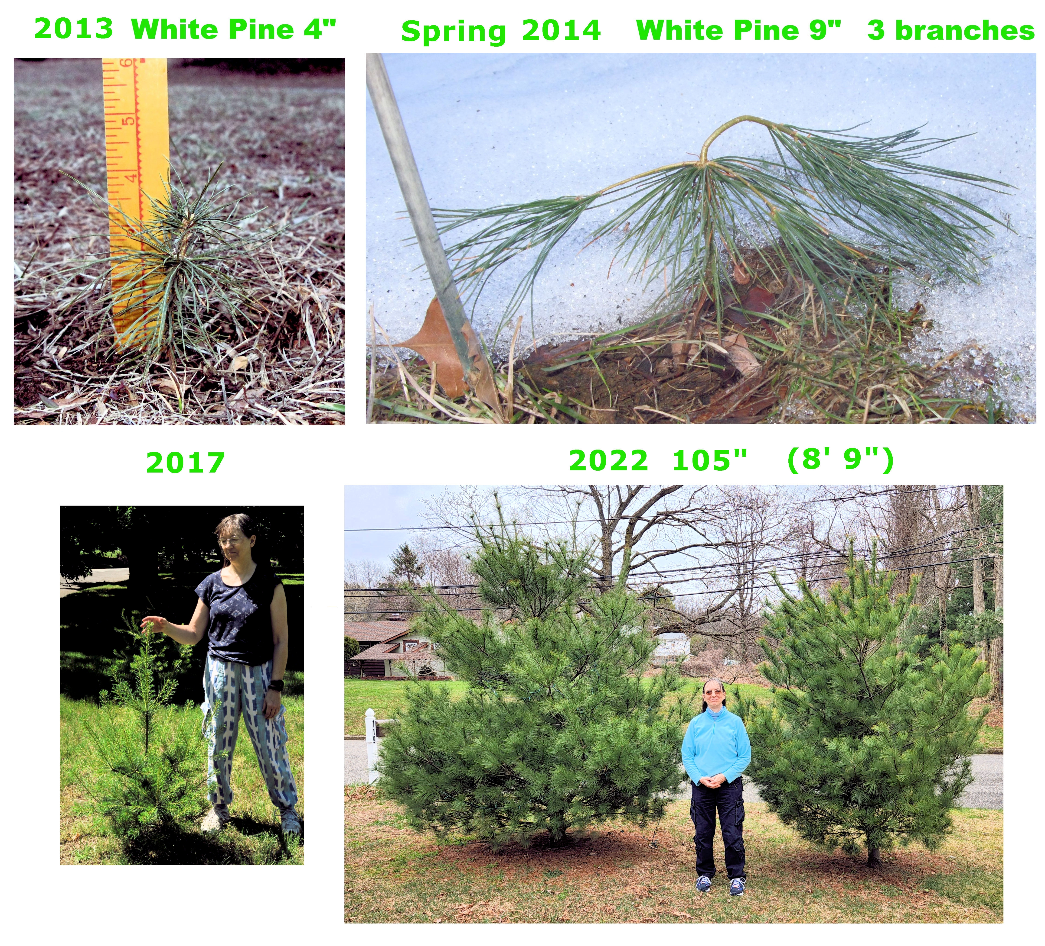
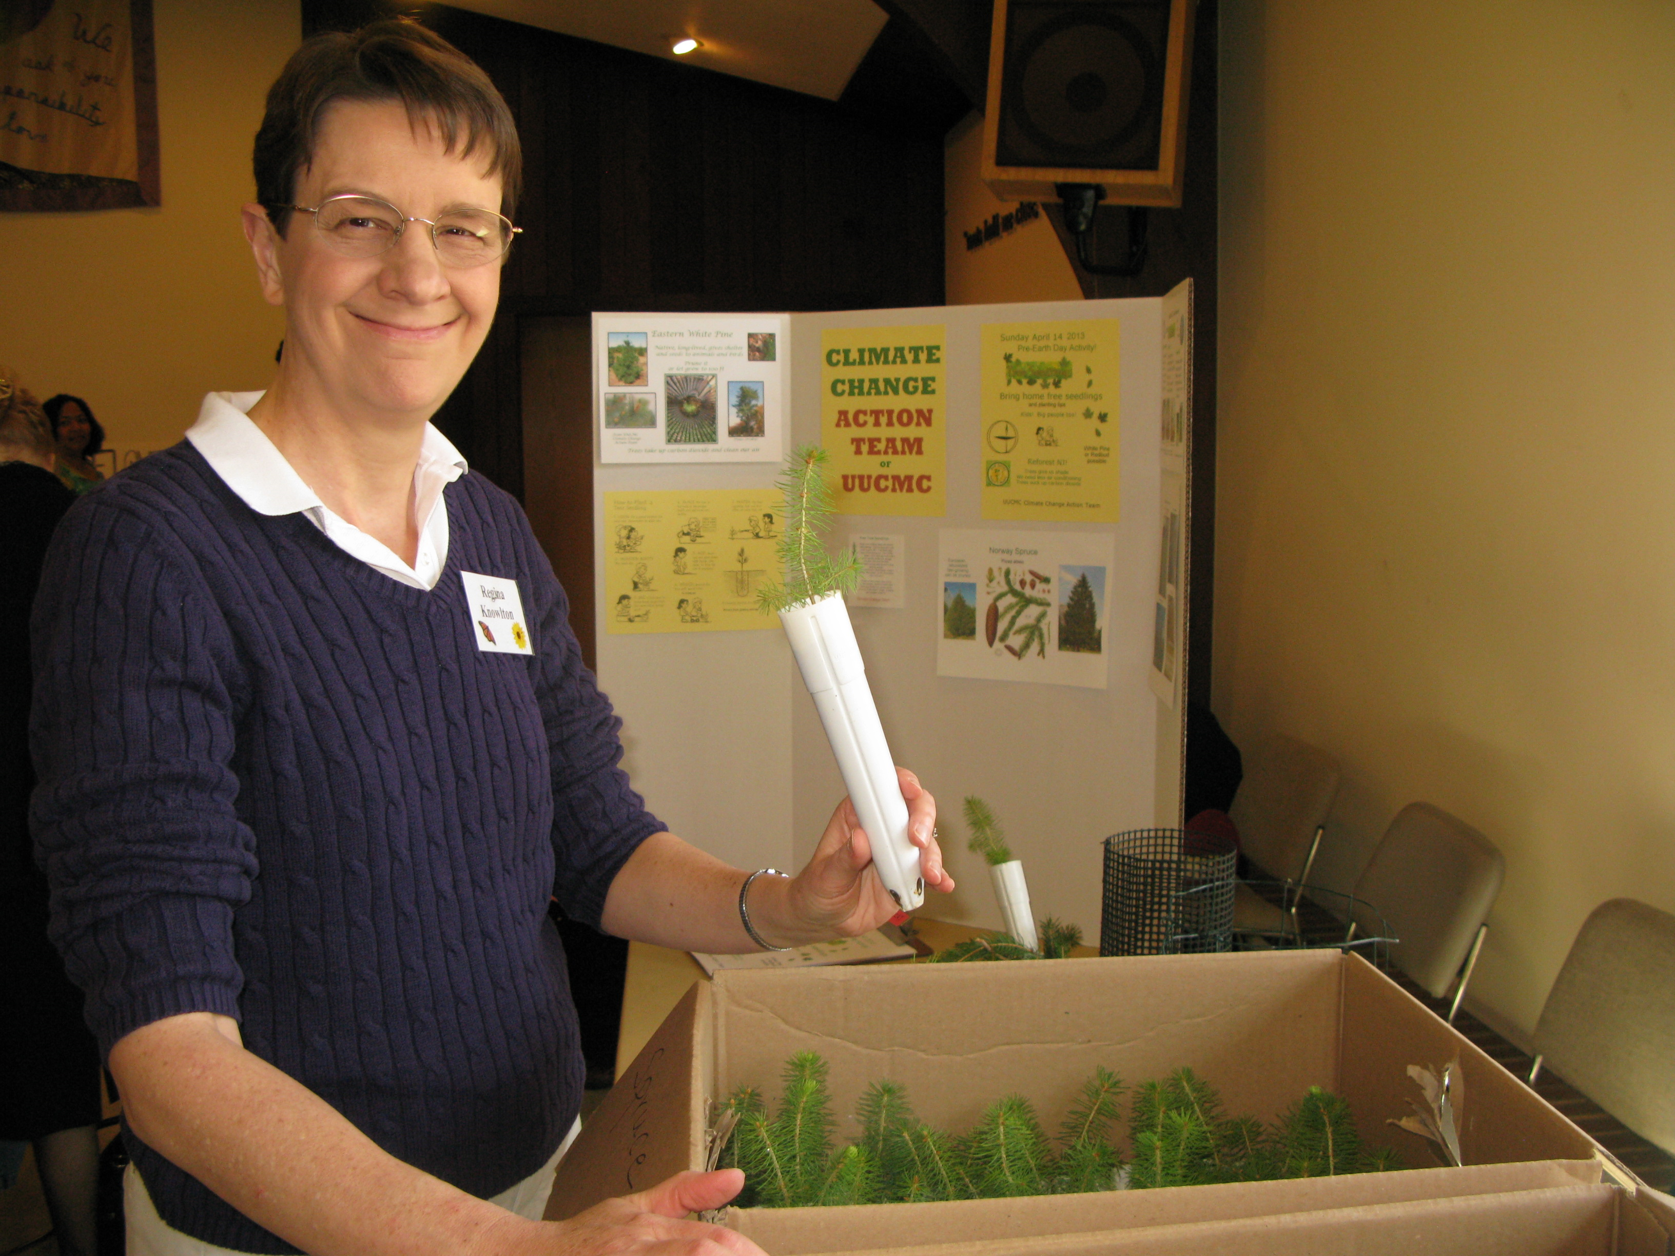
The Earth Works To Heal Itself
Trees and all plants draw down carbon
With help from UUCMC CAT Earth Day Tree Planting 2003
Notes:
READ

Slide 50
TOGETHER WE CAN SAVE OUR WORLD
Source: NASA
Notes:
ID #3 - Can be used in noncommercial online and TV broadcasts of your presentation.
And then on the last of the Apollo missions, this image known as the Blue Marble, became the most reproduced photograph in all of human history. The climate crisis is now the biggest and most serious challenge that humanity has ever faced.
DESCRIPTION: Photo of Earth from Apollo 17, taken as the crew was traveling toward the moon, December 7, 1972
ADDITIONAL TALKING POINTS: This picture is called the “Blue Marble,” taken during the last Apollo mission.
What makes the photograph so unique and powerful is that it captures the complete circle of the earth, helping us see the big picture of our planet – and our lives on it.[1*] It was the first time the Apollo mission made it possible to capture almost the entire southern polar ice cap.[2*]
REFERENCES:
[1*] Ben Cosgrove, “Home, Sweet Home: In Praise of Apollo 17’s ‘Blue Marble’,” Time, April 11, 2014. http://time.com/3879555/blue-marble-apollo-17-photo-of-earth-from-space/
[2*] NASA Visible Earth, “The Blue Marble from Apollo 17," December 7, 1972. http://visibleearth.nasa.gov/view.php?id=55418

Slide 51
INDEX TO ALL BUILDING ELECTRIFICATION
WEBINARS.
The dates/names in GREEN were featured in the March 27 webinar

Slide 52
Together We Can Save Our World from Climate Catastrophe
Through Greenhouse Gas Emissions Drawdown Actions
Clean Electricity | Transportation | Buildings | Food & Land Use | Health, Education, & Gender | Environmental Activism across Sectors
Install rooftop solar or subscribe to community solar | Make new car an EV or hybrid | Replace gas/oil furnace or electric resistance heat OR AC with heat pump | Cut down on meat or adopt vegan or plant-rich diet | Donate to school or fund girls’ education in a place where girls’ educ is repressed | Volunteer for environmental org; focus on climate
Switch to 100% clean electricity service provider | Use public transit | Choose LED bulbs to replace incandescent | Grow a vegetable garden or buy from a local farm market | Give a microloan for a women-owned business | Direct career path toward clean energy or sustainability
Consider geothermal as heat source for heat pump | Cut air travel or buy carbon offset | Get home energy assessment, take efficiency measures – insulate, seal air leaks | Compost food waste, leaves and grass clippings | Support women-owned businesses | Donate $s to environmental orgs focused on climate
Invest in clean energy: community solar, wind, etc. | Conduct virtual meetings | Replace fossil fuel appliances with electric – water or pool heater, dryer, stove | Replace grass in lawn with native species; reduce mowing; plant trees | Donate to support family planning | Run for office as environmental candidate
Switch to solar heat for hot water or pool | Walk, bike or join a carpool when possible | Install smart thermostat; more moderate temps | Replace fossil fuel lawn equipment with electric or battery | Help elect women, BIPOC & climate friendly candidates | Consume less; waste less, esp. plastics
Advocate gov’t FOR clean energy projects, against new fossil fuel projects | Advocate for greener vehicles, high speed rail, network of charging stations | Advocate for building codes – zero carbon buildings, rooftop solar, EV chargers, no gas hookups | Advocate for Indigenous land rights, regenerative farming, against factory farms | Advocate for equity in healthcare, education, & jobs for women or BIPOC | Advocate for climate friendly actions in your town – municipal operations, services
Custom action: electricity | Custom action: transportation | Custom action: buildings | Custom action: food & land use | Custom action: health, educ, gender | Custom action
Notes:
This chart was created by Pat Miller. This is inspired by
“Drawdown: The Most Comprehensive Plan Ever Proposed to Reverse Global Warming” by Paul Hawken

Slide 53
OTHER ACTIONS WE CAN TAKE NOW
Eat less (or no) meat.
Buy local produce. Look for regenerative (soil) farming and no pesticides.
Cut food waste. Compost.
Replace lawn with native plants. Stop mowing. Compost leaves. Plant trees.
Use less energy. Turn back thermostat. Hang clothes to dry; use cold water wash. Cook on electric cooktop, microwave, toaster oven.
Use less plastic. Buy less stuff.
Use public transportation. Travel less.
Conserve water, both indoors and on property – avoid runoff.
Notes:
BY 2050:
Highly energy efficient NETZERO building standards will be the norm.
FOSSIL FUELS are almost totally abandoned.
The world’s electric grids are upgraded for the high electrical loads
GAS STATIONS ARE NON-EXISTENT.
In Maryland, the 1st First US gas station just dumped the pumps & installed EV Chargers
Our plastic mess is gone
We are moving to a plant-based healthy diet.
We MUST make these changes to save lives.
If we wait, the solutions become ever more costly

